Slide 1
Metagenomic Analysis
Experimental Design and Considerations
Swamy Rakesh Adapa| July 22, 2021

Slide 2
Study Design
Clearly define the objective(s) of the study before deciding on the study design and statistical analysis.
You should know your final statistical model and comparisons before beginning your experiment.
Effect size and target population:
Effect Size - Pilot study or from scientific literature
Study size - anticipated effect size and similar previous studies (power analysis)
Well-defined inclusion and exclusion criteria - reduce heterogeneity in the cohort
C. Poussin et al., Interrogating the microbiome: experimental and computational considerations in support of study reproducibility. Drug Discovery Today 23, 1644-1657 (2018).
Notes:
Evaluate the effect size with a pilot study (or from scientific literature) Estimate the study size based on anticipated effect size and similar previous studies (power analysis) Focus on specific aspects with well-defined inclusion and exclusion criteria to reduce heterogeneity in the cohort

Slide 3
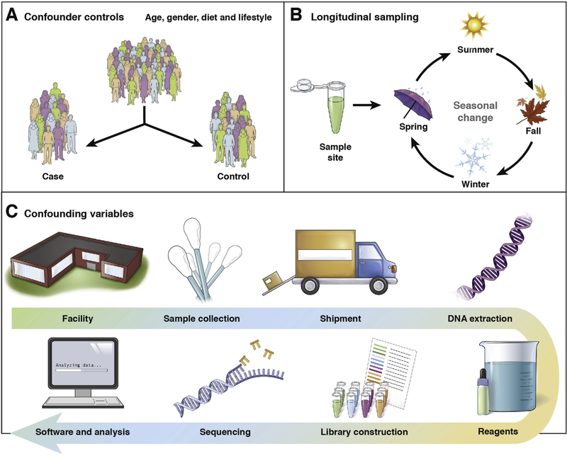
Numerous factors influence clinical microbiome experiment
Allaband, Celeste, et al. "Microbiome 101: studying, analyzing, and interpreting gut microbiome data for clinicians." Clinical Gastroenterology and Hepatology 17.2 (2019): 218-230.
Notes:
(A) Stratification by potential confounders (eg, age, sex, diet, lifestyle factors, and medications) can help resolve differences in microbiota between groups of interest that might otherwise be masked by a confounder effect.⁴⁸ (B) Longitudinal studies are especially powerful because they both control for confounding factors and allow for the assessment of community stability.⁴⁰ (C) For all studies, standardizing technical factors and sample processing are essential to control for variation introduced by every step of the process: kit reagents, primers, sample storage, and other factors. The collection and curation of metadata about all aspects of each sample, from clinical variables to sample processing, are crucial for data interpretation; without metadata, it is difficult to draw meaningful conclusions from sequencing data

Slide 4

Challenges
(Work by Uwe Kils) http://www.ecoscope.com/iceberg/

Slide 5
Control Group(s)
Clinical phenotype distinct from the one under study while matching other relevant criteria to avoid confounding factor
Longitudinal studies,
Collecting baseline samples before and after treatment to establish participant’s own control.
Multiple control groups selected on various criteria can provide more insights
Collect as many samples as possible.
As the increased statistical power of larger samples sizes cannot be overlooked when the difficulties of gaining approval and recruiting subjects represent a substantial barrier.
C. Poussin et al., Interrogating the microbiome: experimental and computational considerations in support of study reproducibility. Drug Discovery Today 23, 1644-1657 (2018).

Slide 6
Collection Parameters
Donor Criteria
Dx Criteria
Gender
Male, Female
Specific cohorts
Age
Adult, Geriatric, Pediatric
Race/Ethnicity
White, Black, Hispanic, Asian
Specific cohorts by Race/Ethnicity
BMI
>30, <20, Specific Range
Specific cohorts by BMI range/value
Dietary Restrictions
Vegan, Vegetarian, Paleo, Etc
Specific cohorts by dietary type
Diagnosis
Physician confirmed
Screened
Test results
Disease Severity/Flares/etc
Treatment specifics
Naïve
Specific Treatment
Specific washout
Specific exclusion (such as Antibiotics)
Current medications
https://info.bioivt.com/microbiome-collection-webinar-materials-lp

Slide 7
Timing and frequency of sample collection:
Level of invasiveness of the sampling procedure should always be minimized.
Cross-sectional sampling
Diagnostic microbiome signatures
Temporally stable microbiome types.
Repeated sampling (same subject)
To get insight into temporal dynamics and a comprehensive view of microbial community changes.
Monitoring disease severity or response to a treatment.
Discriminate between dysbiosis associated with disease and preclinical states and short-term changes followed by resilience.
Sampling frequency should be similar between subjects
C. Poussin et al., Interrogating the microbiome: experimental and computational considerations in support of study reproducibility. Drug Discovery Today 23, 1644-1657 (2018).

Slide 8
Sample Criteria
Sample Types
Gut (Feces) Urine
Nostril Mouth
Skin Hair
Earwax
Sample consistency/viscosity/origin
Loose, firm, etc
Location of skin swab/hair collection
Volume required
3 grams
Fill a specific container
Time points
During an active flare
Pre/post antibiotics
4 weeks apart
https://info.bioivt.com/microbiome-collection-webinar-materials-lp

Slide 9
Possible confounding factors:
Animal Studies: maternal, environment, facility, cage and vendor effects.
A more stable microbiome can be generated by selective breeding of siblings over several generations
Use germ-free mice gavaged or transplanted with the same inoculum from mixed-genotype litters
Order mice from the same vendor
Standardize housing conditions and minimize exposure of animals to stressors
Randomize and cohouse treatment-control mice across litters and/or cages
Distribute littermates over multiple cages and maximize the number of cages for each study group if treated and untreated animals cannot be cohoused
Introduce systematic variation of parameters within one research institution to avoid extreme local standardization and reduced reproducibility between different sites
C. Poussin et al., Interrogating the microbiome: experimental and computational considerations in support of study reproducibility. Drug Discovery Today 23, 1644-1657 (2018).

Slide 10
Possible confounding factors:
Human studies: lifestyle and clinical factors
Apply exclusion criteria (e.g., list of exclusion criteria from the NIH Human Microbiome Project)
Balance factors across the experimental groups
Carefully select control groups
C. Poussin et al., Interrogating the microbiome: experimental and computational considerations in support of study reproducibility. Drug Discovery Today 23, 1644-1657 (2018).

Slide 11
Consistency
Procedures, protocols & collected information
Implement consistent procedures and minimize extraneous variables across groups
Collect maximum information about samples and experimental procedures to allow reproducibility

Slide 12
Collection - Shipment
Time to preservation / shipment / receipt
4 hrs, 24 hrs, 1-7 days, none
Initial store at -20C, transfer to -80 within specific time frame
Collection device
Fisherbrand™ Commode Specimen Collection System
DNA GenotekInc
NorgenBiotekSaliva
BD BBL™ CultureSwab™ EZ collection and transport systems
Storage container
OMNIgene®•GUT
NorgenBiotekSaliva, Urine, Stool
DNA Genotek Inc
Storage solution
Container specific
Custom
https://info.bioivt.com/microbiome-collection-webinar-materials-lp

Slide 13
What is the optimal protocol for collecting a microbiome sample for analysis?
There is still an ongoing debate on the best way to collect and store a sample for analysis of the microbiome.
In short, there is no perfect method because the choice will depend on feasibility, cost, patient acceptance, and which methods will be used to read the microbiome downstream.
Even the most aggressive homogenizing procedure to break bacterial cell walls still may miss important organisms.

Slide 14
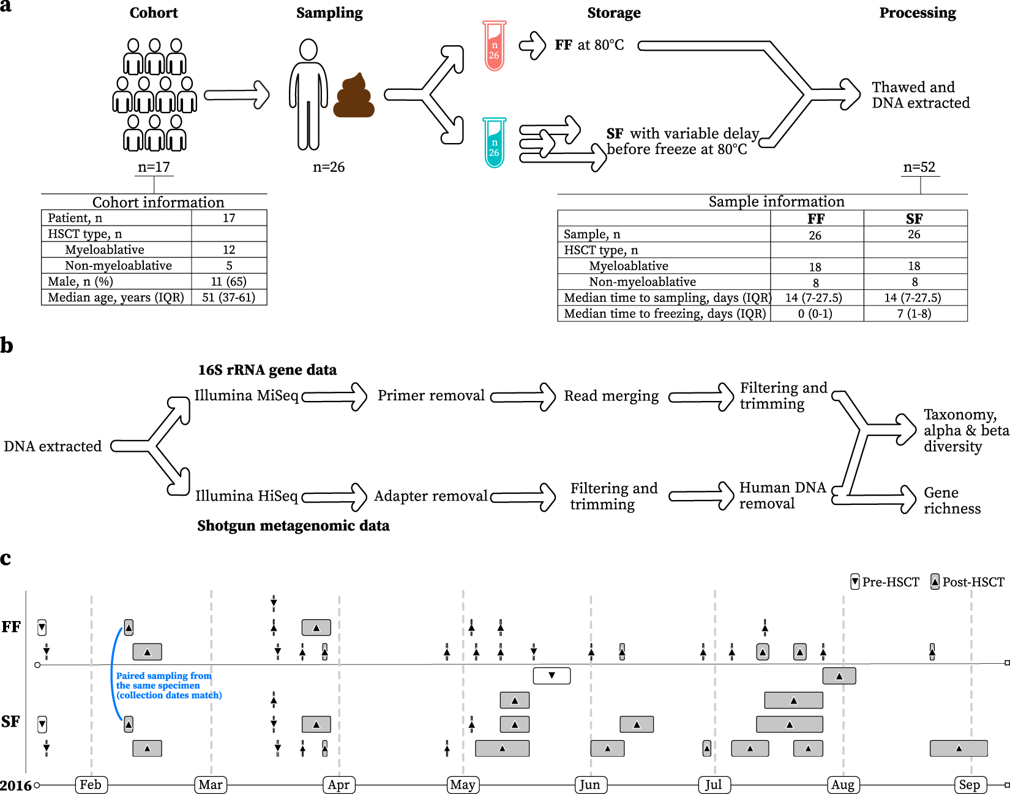
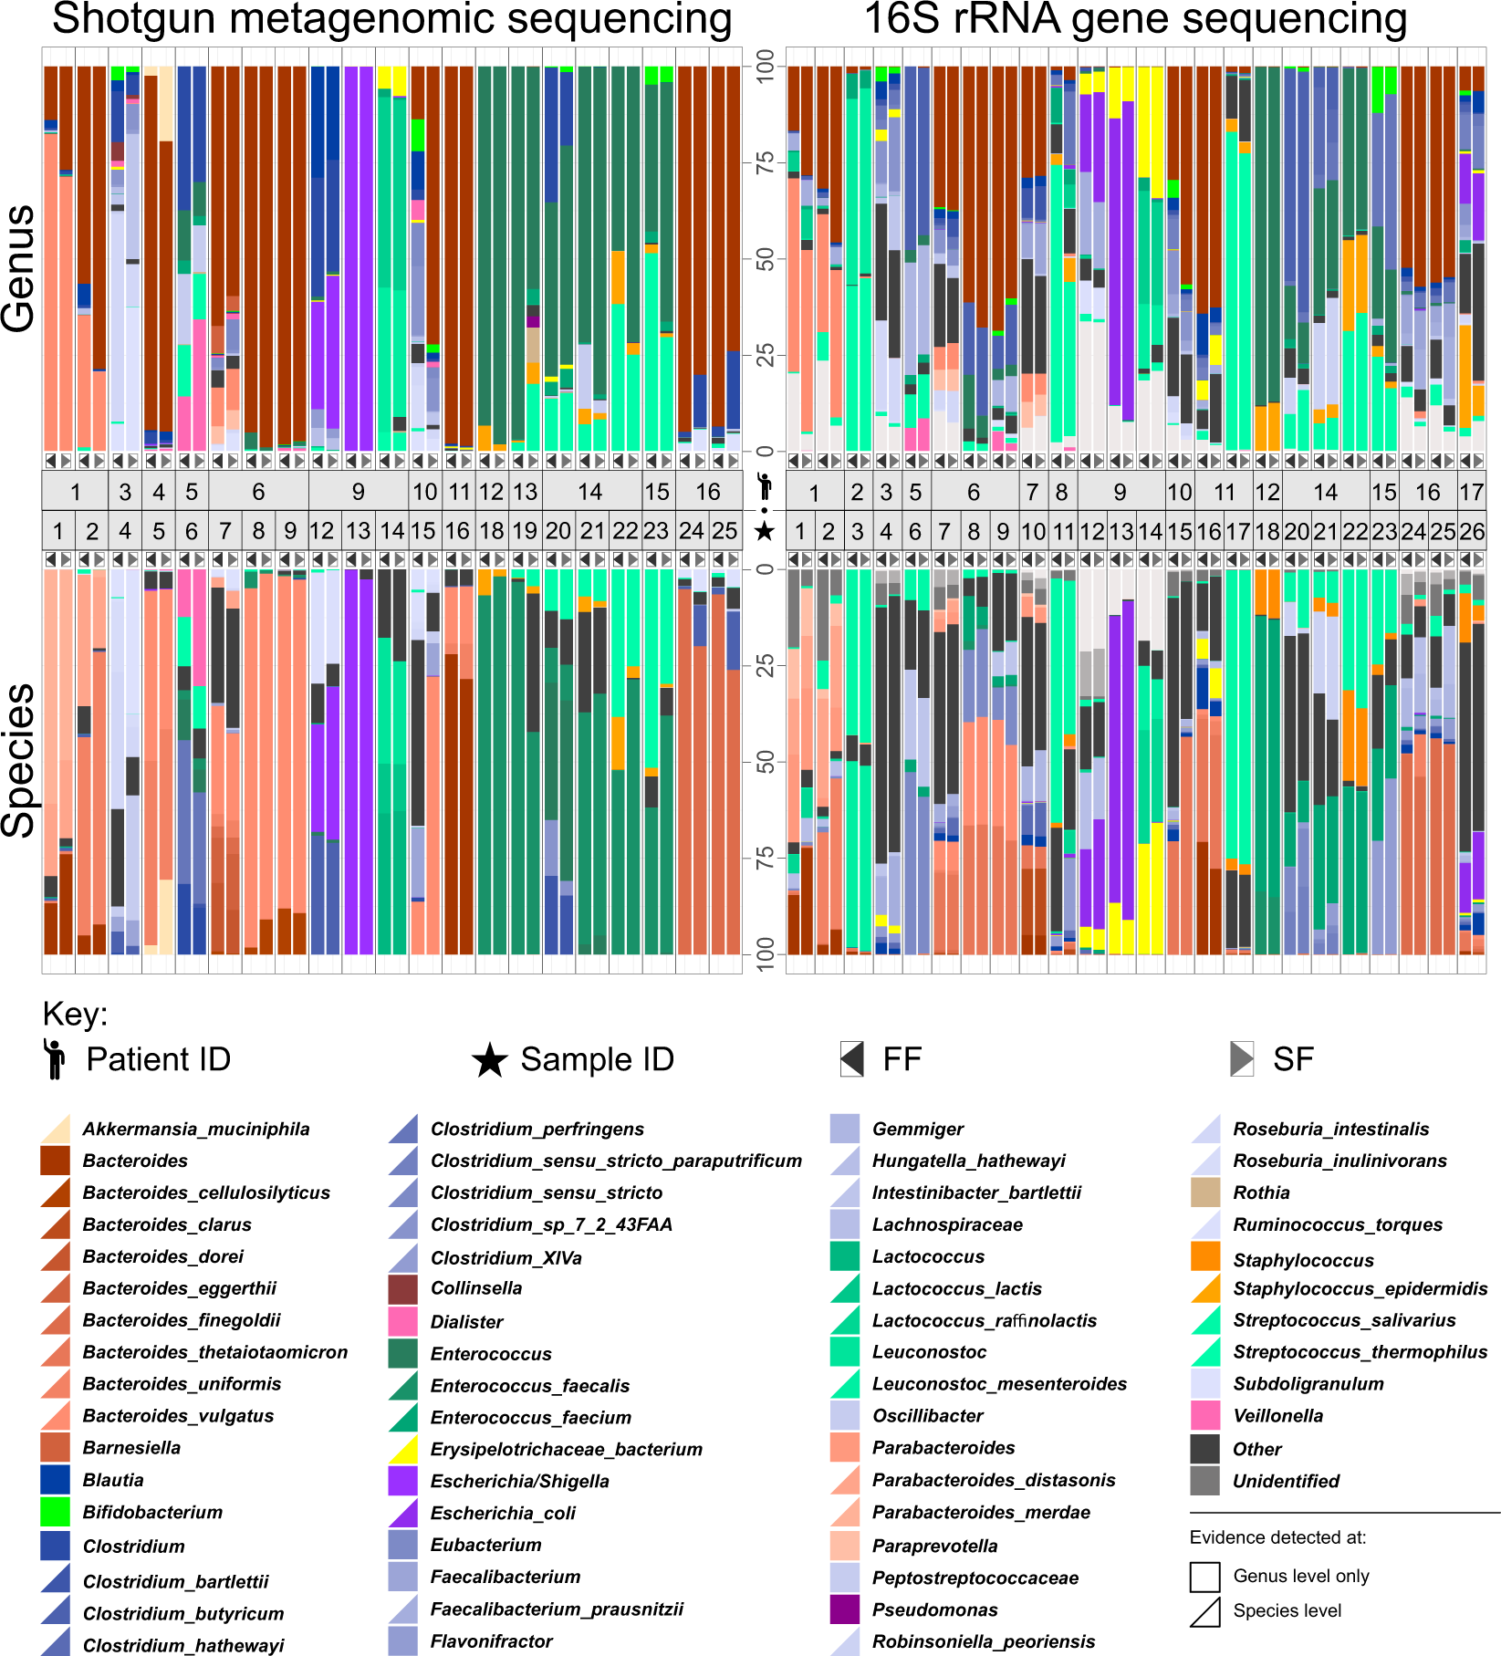
Sample collection Fresh Frozen vs Stabilized Frozen
This not true is all cases – A huge divide in the community.
Study shows that SF is comparable to FF protocols in a diseased and hospitalized cohort using both 16S rRNA gene and shotgun metagenomic sequencing data
Ilett, E.E., Jørgensen, M., Noguera-Julian, M. et al. Gut microbiome comparability of fresh-frozen versus stabilized-frozen samples from hospitalized patients using 16S rRNA gene and shotgun metagenomic sequencing. Sci Rep 9, 13351 (2019)
Notes:
Current:
17 patients undergoing haematopoietic stem cell transplantation (HSCT)
No significant differences.
Previous Studies:
significant increase in the Sutterella genus in SF versus FF samples
Faecalibacterium, Sporobacter, Clostridium XVIII, and Clostridium XIVa, with differences being exacerbated in samples of low diversity

Slide 15
Sample preparation
What may seem like small technical details introduced during sample extraction/preparation can lead to large changes, or technical bias, in the data.
Prepare more samples than you are going to need, i.e. expect some will be of poor quality, or fail
Preparation stages should occur across all samples at the same time (or as close as possible) and by the same person
Spend time practicing a new technique to produce the highest quality product you can, rely on.
Quality should be established using Fragment analysis traces (pseudo-gel images, RNA RIN > 7.0)
DNA/RNA should not be degraded
260/280 ratios for RNA should be approximately 2.0 and 260/230 should be between 2.0 and 2.2. Values over 1.8 are acceptable
Quantity should be determined with a Fluorometer, such as a Qubit.

Slide 16
Sequencing errors
Sequencing errors or mis-called bases occur when a sequencing method calls one or more bases incorrectly leading to an incorrect read.
The chance of a sequencing error is generally known and quantifiable, thanks to extensive testing and calibration of the sequencing machines
Each base in a read is assigned a quality score, indicating confidence that the base has been called correctly.
https://www.broadinstitute.org/crd/wiki/index.php/Sequencing_error

Slide 17
Sources of Sequencing Errors
The importance and the relative effect of each error source on downstream applications depend on many factors, such as:
sample acquisition
reagents
tissue type
protocol
instrumentation
experimental conditions
analytical application
the ultimate goal of the study.
The role of replicates for error mitigation in next-generation sequencing. Robasky et al. Nature Reviews Genetics, 2014, 15, 56-62

Slide 18
Sources of Sequencing Errors
Sequencing errors can stem from any time point throughout the experimental workflow, including initial sequence preparation, library preparation and sequencing.
The role of replicates for error mitigation in next-generation sequencing. Robasky et al. Nature Reviews Genetics, 2014, 15, 56-62

Slide 19
Sample Preparation
User errors; for example, mislabelling
Degradation of DNA and/or RNA from preservation methods; for example, tissue autolysis, nucleic acid degradation and crosslinking during the preparation of formalin-fixed, paraffin-embedded (FFPE) tissues
Alien sequence contamination; for example, those of mycoplasma and xenograft hosts
Low DNA input
The role of replicates for error mitigation in next-generation sequencing. Robasky et al. Nature Reviews Genetics, 2014, 15, 56-62

Slide 20
Library Preparation
User errors; for example, carry-over of DNA from one sample to the next and contamination from previous reactions
PCR amplification errors
Primer biases; for example, binding bias, methylation bias, biases that result from mispriming, nonspecific binding and the formation of primer dimers, hairpins and interfering pairs, and biases that are introduced by having a melting temperature that is too high or too low
3ʹ-end capture bias that is introduced during poly(A) enrichment in high-throughput RNA sequencing
Private mutations; for example, those introduced by repeat regions and mispriming over private variation
Machine failure; for example, incorrect PCR cycling temperatures
Chimeric reads
Barcode and/or adaptor errors; for example, adaptor contamination, lack of barcode diversity and incompatible barcodes
The role of replicates for error mitigation in next-generation sequencing. Robasky et al. Nature Reviews Genetics, 2014, 15, 56-62

Slide 21
Sequencing and Imaging
• User errors; for example, cluster crosstalk caused by overloading the flow cell
Dephasing; for example, incomplete extension and addition of multiple nucleotides instead of a single nucleotide
‘Dead’ fluorophores, damaged nucleotides and overlapping signals
Sequence context; for example, GC or AT richness, homologous and low-complexity regions, and homopolymers
Machine failure; for example, failure of laser, hard drive, software and fluidics
Strand biases
The role of replicates for error mitigation in next-generation sequencing. Robasky et al. Nature Reviews Genetics, 2014, 15, 56-62

Slide 22
Reproducible reanalysis
Microbiome Quality Control project
Showed that differences in the computational pipeline, even on the same data, could lead to large differences in the inferred outcomes at levels from the species to the phylum.
Many different laboratories could independently reproduce similar results on the same samples by following a consistent written protocol.
Version Control
The version and the parameters used when invoking a software during data analysis should be recorded.
Different versions of the same software could have different default parameters, and uncorrected bugs that could impact the analysis
Versions of packages used by specific software such as R or python, should be documented as well
Sinha, Rashmi, et al. "Assessment of variation in microbial community amplicon sequencing by the Microbiome Quality Control (MBQC) project consortium." Nature biotechnology 35.11 (2017): 1077.

Slide 23
Reproducible reanalysis
Dedicated workflow management software (e.g., Snakemake, bpipe or Galaxy)
To ensure that data analysis can be repeated by using analysis software used in the same order and with the same parameters
Use containers (i.e., lightweight virtual computers)
To ensure the workflows are executed in the same computing environment when repeating data analysis (e.g., Docker and Docker-based solutions such as biocontainers or bioboxes, singularity)
Leverage crowdsourcing to validation of results by external researchers using their own analysis methods
Starting from the raw data or restricted to specific steps of the data analysis
Can also be applied to evaluate reproducibility of experimental methods
To verify results and biological conclusions of a metagenomics study

Slide 24
Power Analysis
Microbiome studies often compare groups of microbial communities with different environmental exposures, or to which different interventions have been applied.
Pairwise distance metrics facilitate standardized comparison of community membership between individual study subjects.
The design of microbiome studies demands consideration of statistical power
An adequate number of subjects must be recruited to ensure that the effect expected from the exposure or intervention of interest can be detected
C. Poussin et al., Interrogating the microbiome: experimental and computational considerations in support of study reproducibility. Drug Discovery Today 23, 1644-1657 (2018).
Notes:
by addressing the problems of differential membership and mutual absence.

Slide 25
Tools
Micropower
Kelly, Brendan J., et al. "Power and sample-size estimation for microbiome studies using pairwise distances and PERMANOVA." Bioinformatics 31.15 (2015): 2461-2468.
HMP tool
La Rosa PS, Brooks JP, Deych E, Boone EL, Edwards DJ, et al. (2012) Hypothesis Testing and Power Calculations for Taxonomic-Based Human Microbiome Data. PLOS ONE 7(12): e52078.
ShinyMB
Mattiello, Federico, et al. "A web application for sample size and power calculation in case-control microbiome studies." Bioinformatics 32.13 (2016): 2038-2040.

Slide 26
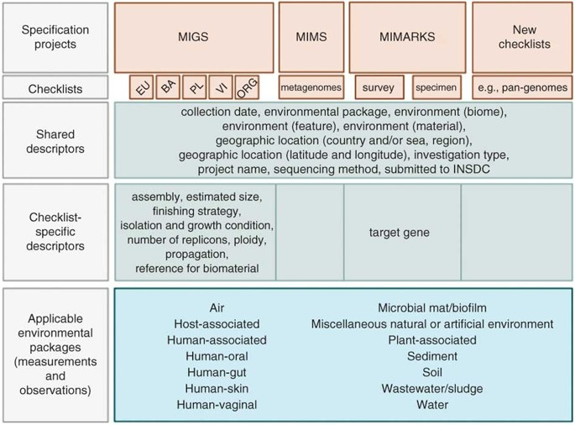
Genomic Standards Consortium (GSC) - MIMARKS
The Genomic Standards Consortium (GSC) is an open-membership working body formed in September 2005.
The aim of the GSC is making genomic data discoverable.
The GSC enables genomic data integration, discovery and comparison through international community-driven standards.
GSC proposed standards for describing genomic sequences— the “minimum information about a genome sequence” (MIGS)—and metagenomic sequences—the “minimum information about a metagenome sequence” (MIMS)

Slide 27
The core MIxS team developed the following environmental packages These packages are available as separate spreadsheets:
Air (download MIxS-air only)
Built-environment (download MIxS-built environment only)
Host-associated (download MIxS-host associated only)
Human-associated (download MIxS-human associated only)
Human-gut (download MIxS-human gut only)
Human-oral (download MIxS-human oral only)
Human-skin (download MIxS-human skin only)
Human-vaginal (download MIxS-human vaginal only)
Microbial mat/biofilm (download MIxS-microbial mat/biofilm only)
Miscellaneous natural or artificial environment (download MIxS-misc. natural or artificial environment only)
Plant-associated (download MIxS-plant associated only)
Sediment (download MIxS-sediment only)
Soil (download MIxS-soil only)
Wastewater/sludge (download MIxS-wastewater/sludge only)
Water (download MIxS-water only)
Hydrocarbon resources-cores (download from GitHub)
Hydrocarbon resources-fluids/swabs (download from GitHub)
Newly Published MIxS Packages:
Minimum Information About a Single Amplified Genome (MISAG) (download from GitHub)
Minimum Information About a Metagenome-Assembled Genome (MIMAG) (download from GitHub)
Minimum Information About an Uncultivated Virus Genome (MIUViG) (download from GitHub)
In-Progress MIxS Standards:
Parasite Microbiome MIxS (MIxS-PMP)
Agricultural Microbiome MIxS (MIxS-Ag)
https://gensc.org/mixs/

Slide 28
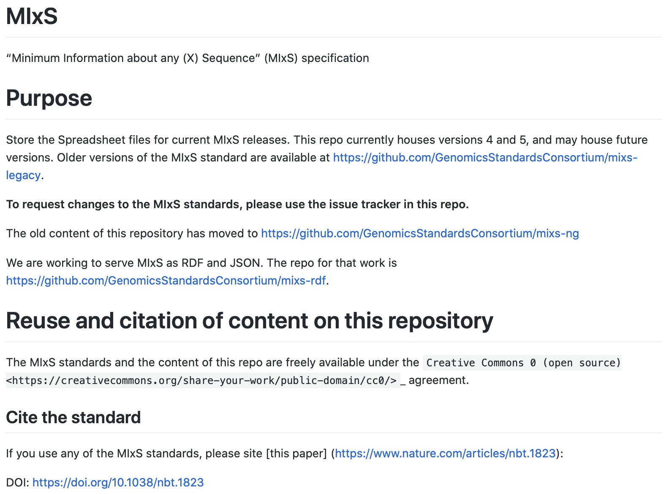
GitHub: https://github.com/GenomicsStandardsConsortium/mixs

Slide 29
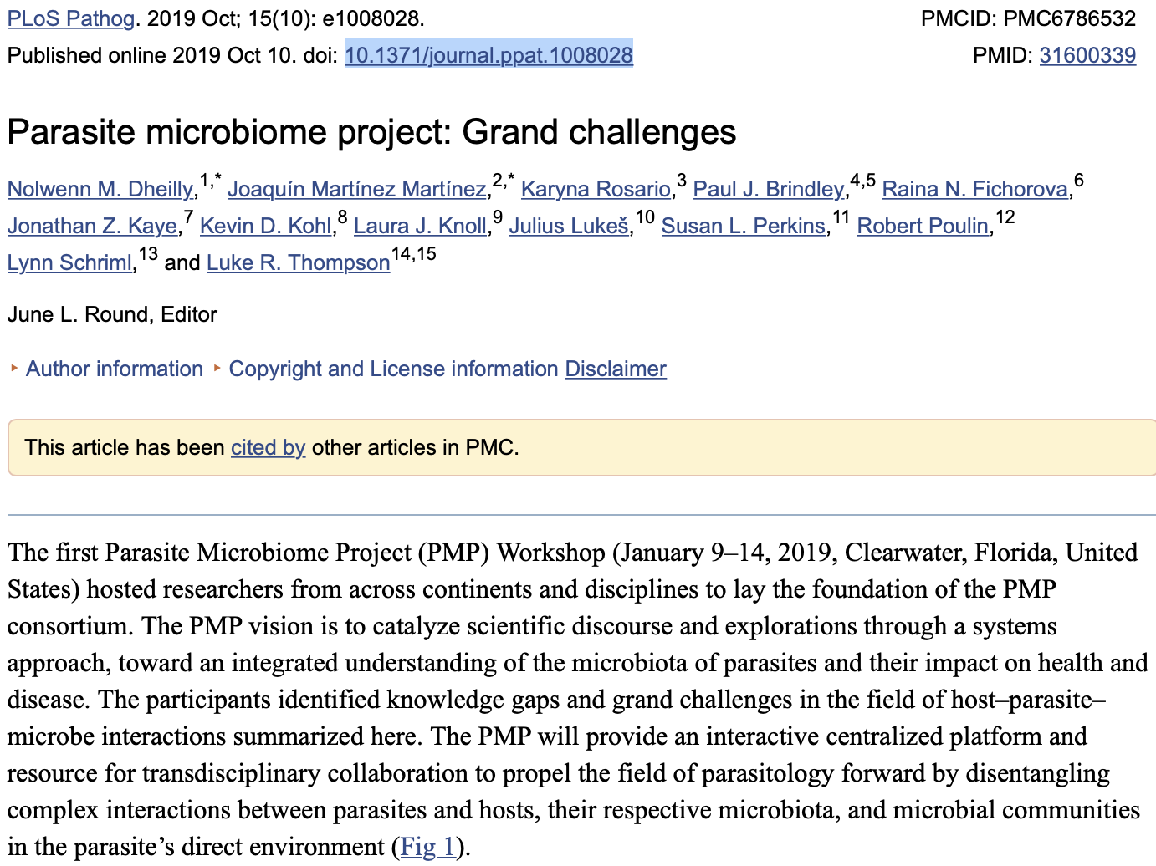
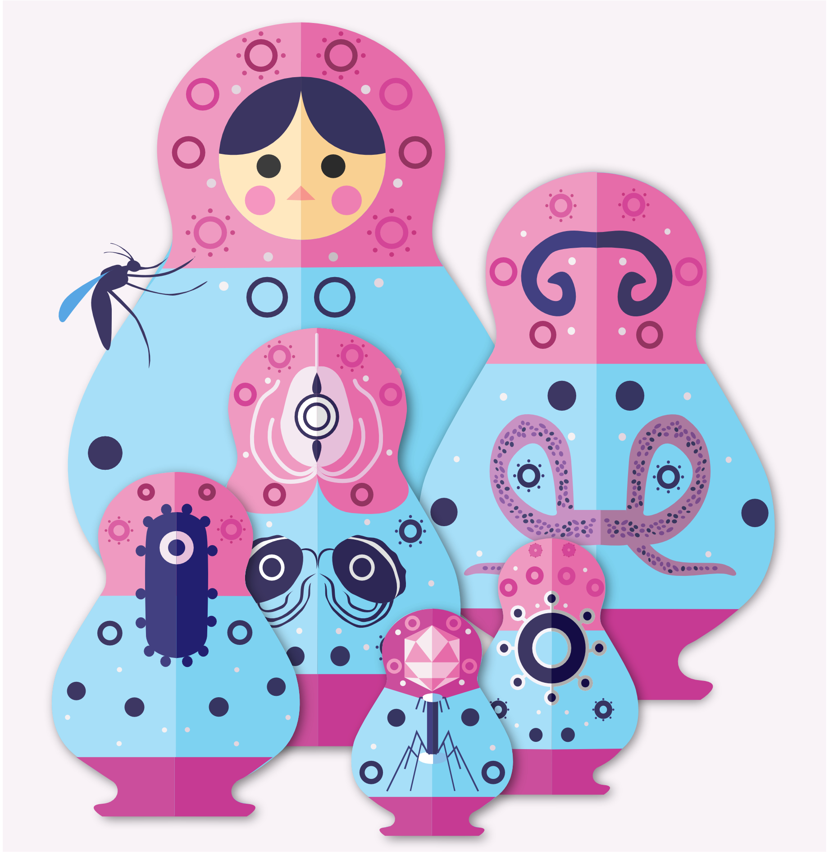
Dheilly NM, Martínez Martínez J, Rosario K, Brindley PJ, Fichorova RN, Kaye JZ, et al. (2019) Parasite microbiome project: Grand challenges. PLoS Pathog 15(10): e1008028.

Slide 30
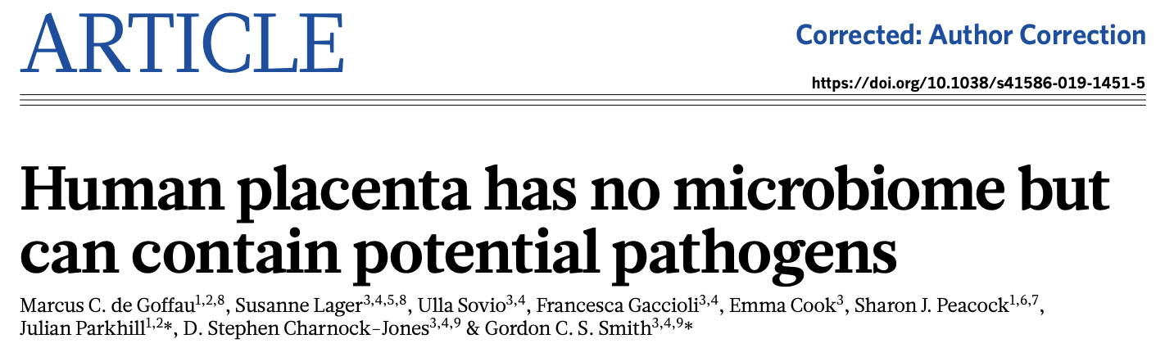
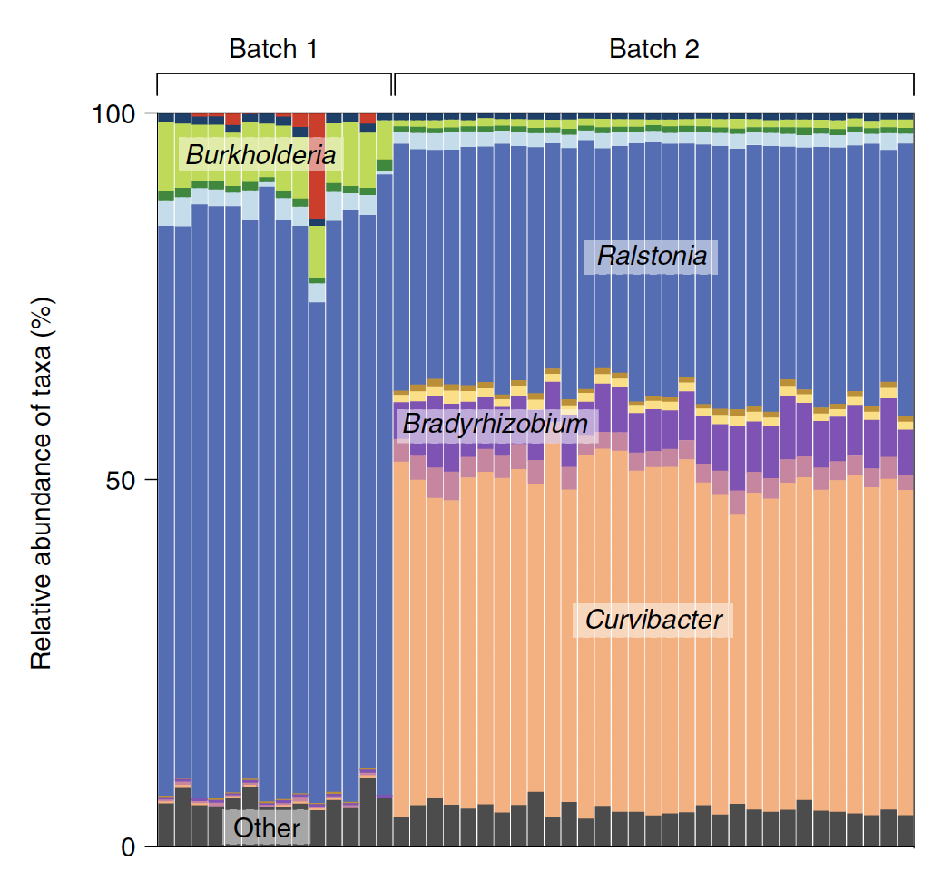
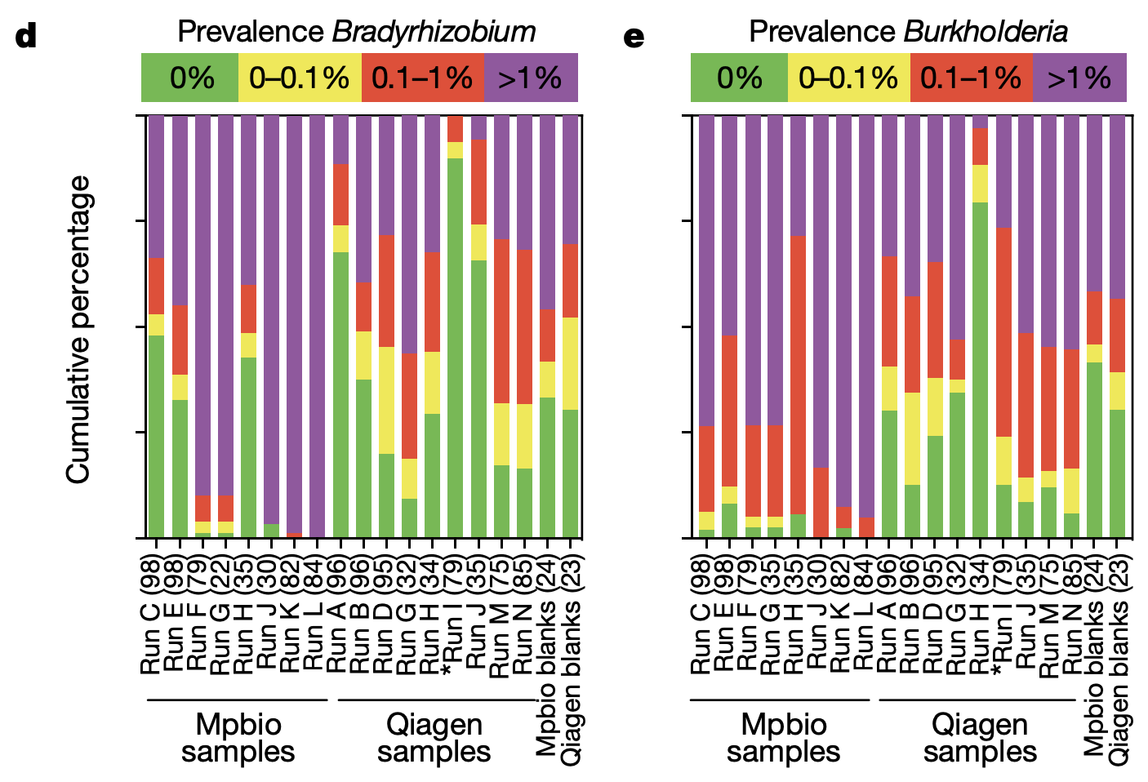
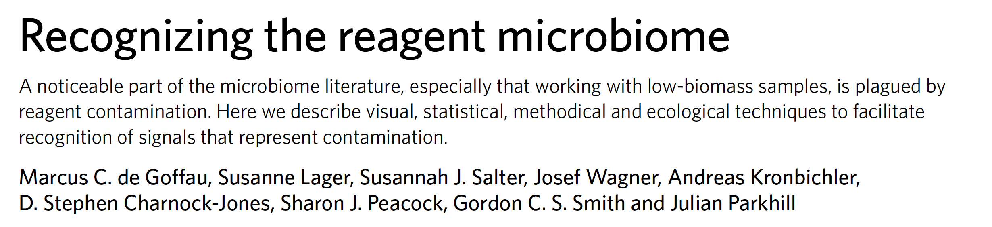
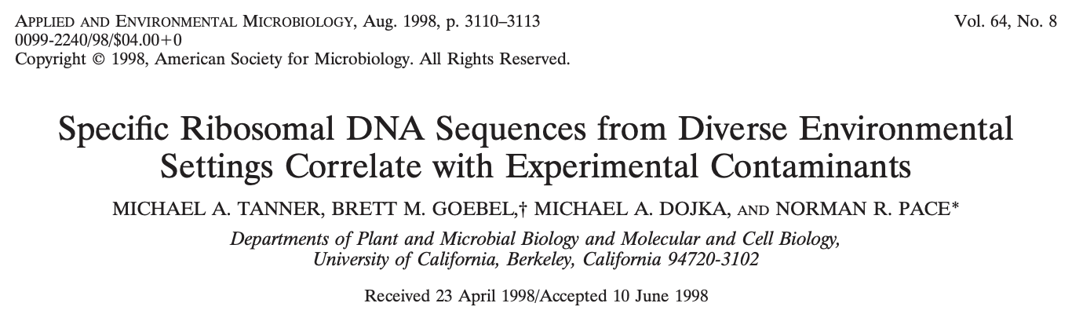
Kit’ome - Reagent microbiome

Slide 31
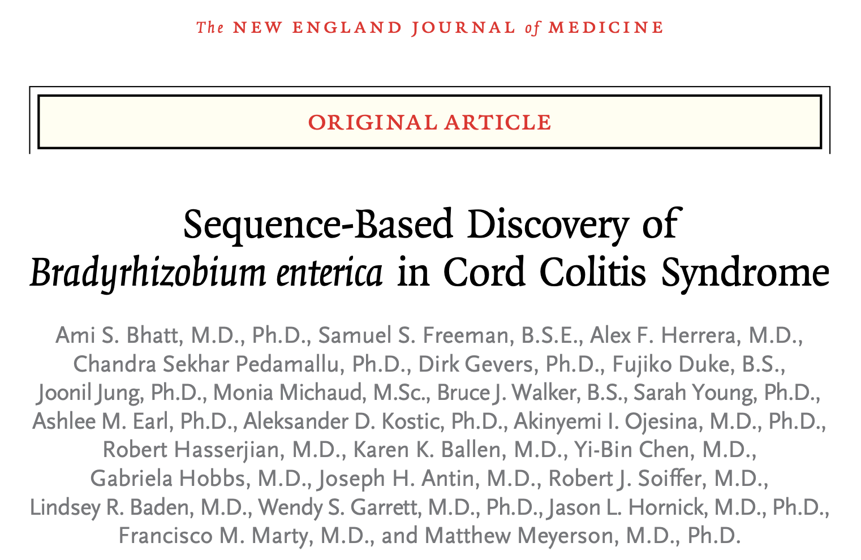
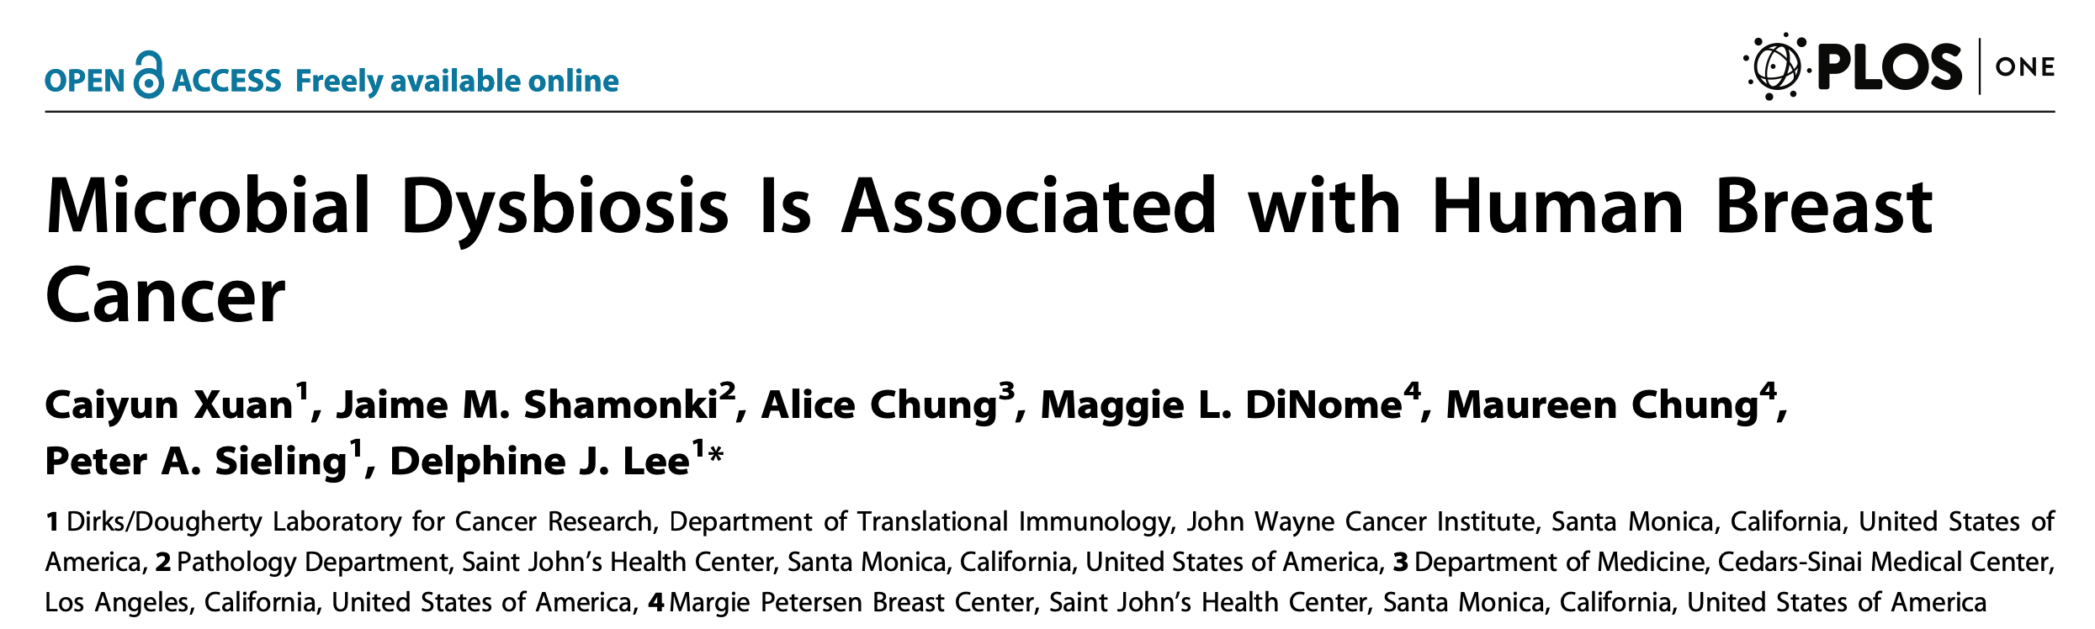
Kit’ome - Reagent microbiome
Breast tissue from cancer patients and normal controls
Different abundances of Methylobacterium radiotolerans and Sphingomonas yanoikuyae.
Methylobacteriaceae and Shingomonadaceae popped up in some of the DNA extraction kits.
Bradyrhizobium enterica, in patients with a colitis syndrome.
Bradyrhizobium were also detected in DNA extraction kits

Slide 32
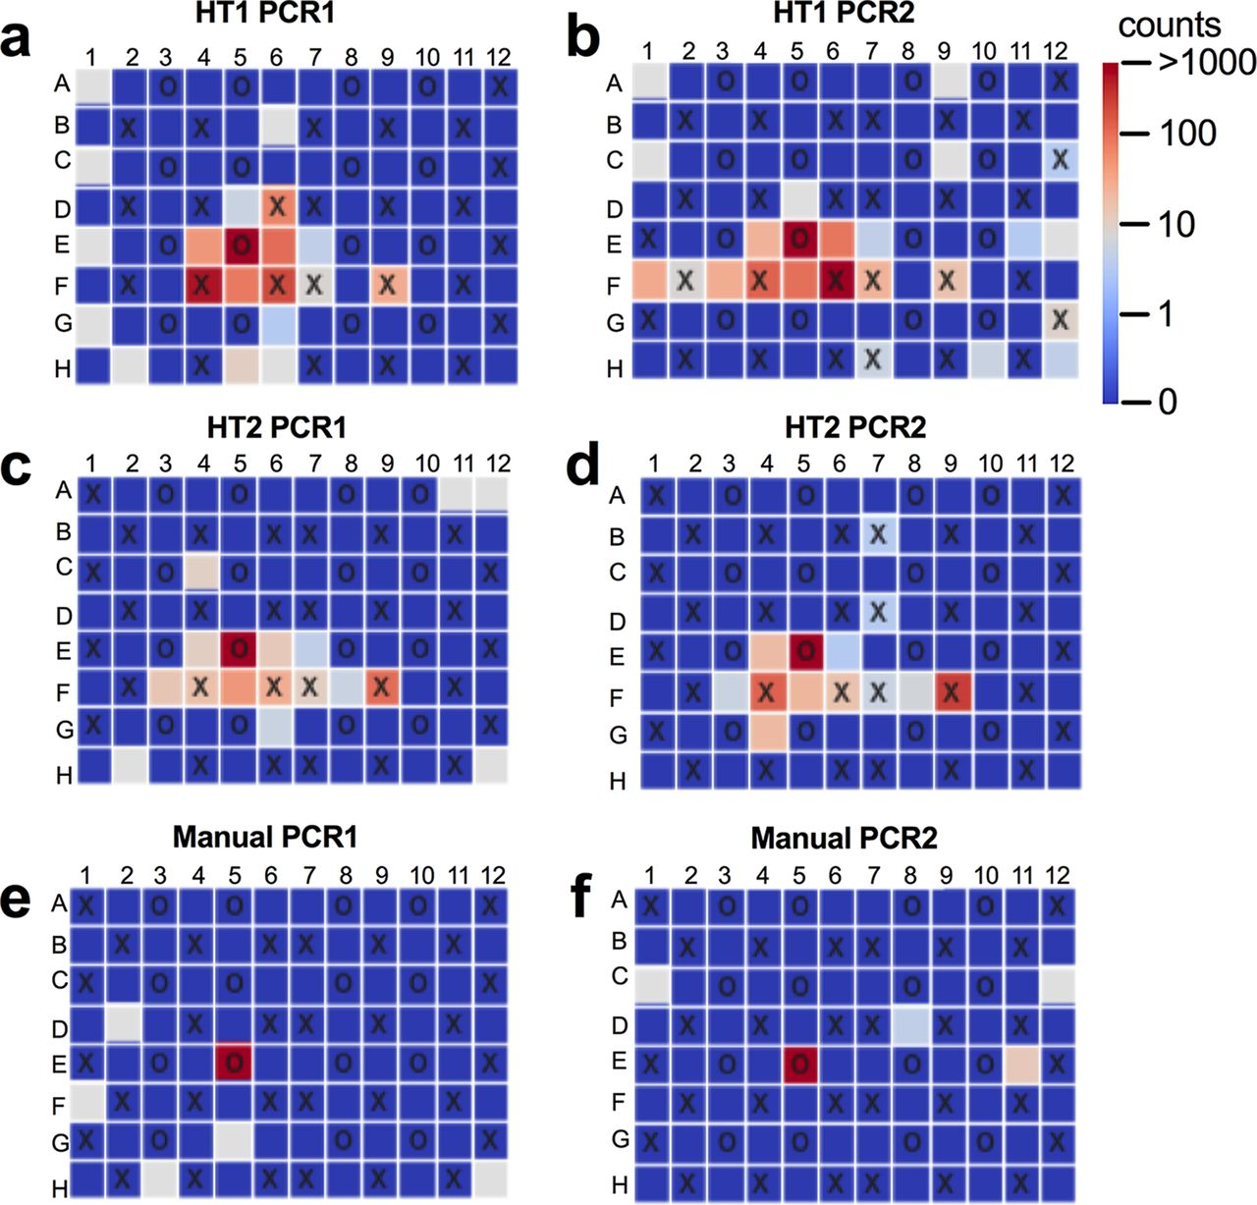
Well-to-Well Contamination
Decreased cost of 16S rRNA -> Automation
Outsourced samples are always processed using High-throughput platforms.
Between-sample contamination is often neglected.
Study found
DNA extraction primary contamination.
Lesser extent during library preparation
Barcode leakage was negligible.
Recommendations:
Samples should be randomized across plates
Samples of similar biomasses should be processed together
Manual single-tube extractions or hybrid plate-based cleanups should be employed.
J. J. Minich et al., Quantifying and Understanding Well-to-Well Contamination in Microbiome Research. mSystems 4, e00186-00119 (2019).

Slide 33
Need for Controls – Blanks & Mock
Positive or Mock Community control
To assess sequencing error rate
Negative or water extraction sample.
Essential for low biomass samples
Probably a good idea for high biomass samples
Airborne contaminants.
Autoclave does not kill DNA.
Avoid simplistic removals of taxa or operational taxonomic units (OTUs) appearing in negative controls – The contaminant could be real.

Slide 34
Batch Effect – Run Preparation
Do not just sequence samples as they come.
Human Microbiome Project
Largest signal in that study was where the DNA extractions were done - St. Louis or Houston (Regional effect on the microbiome?)
Geographic region was perfectly confounded with who did the sampling, extractions, amplifications, and sequencing.
Salter et. al, found that the differences they observed were due to differences in the contaminants that were present in the DNA extraction kits that they used.
Two batches of extractions used different lots of extraction kits
Treatment groups were confounded with the DNA extraction kit lots
Wait until you have all of your samples.
Either randomize the samples or thoughtfully block your samples.
So that treatment groups are evenly represented across your extraction sets and sequencing runs.
Turner P, Turner C, Jankhot A, Helen N, Lee SJ, et al. (2012) A Longitudinal Study of Streptococcus pneumoniae Carriage in a Cohort of Infants and Their Mothers on the Thailand-Myanmar Border. PLOS ONE 7(5): e38271.
Salter, S.J., Cox, M.J., Turek, E.M. et al. Reagent and laboratory contamination can critically impact sequence-based microbiome analyses. BMC Biol 12, 87 (2014)

Slide 35
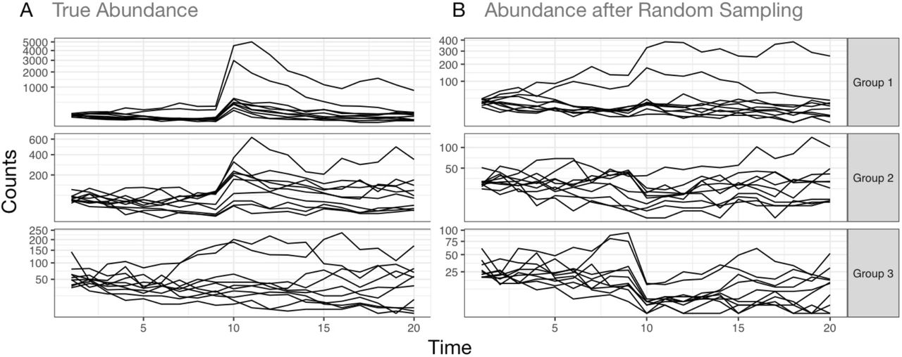
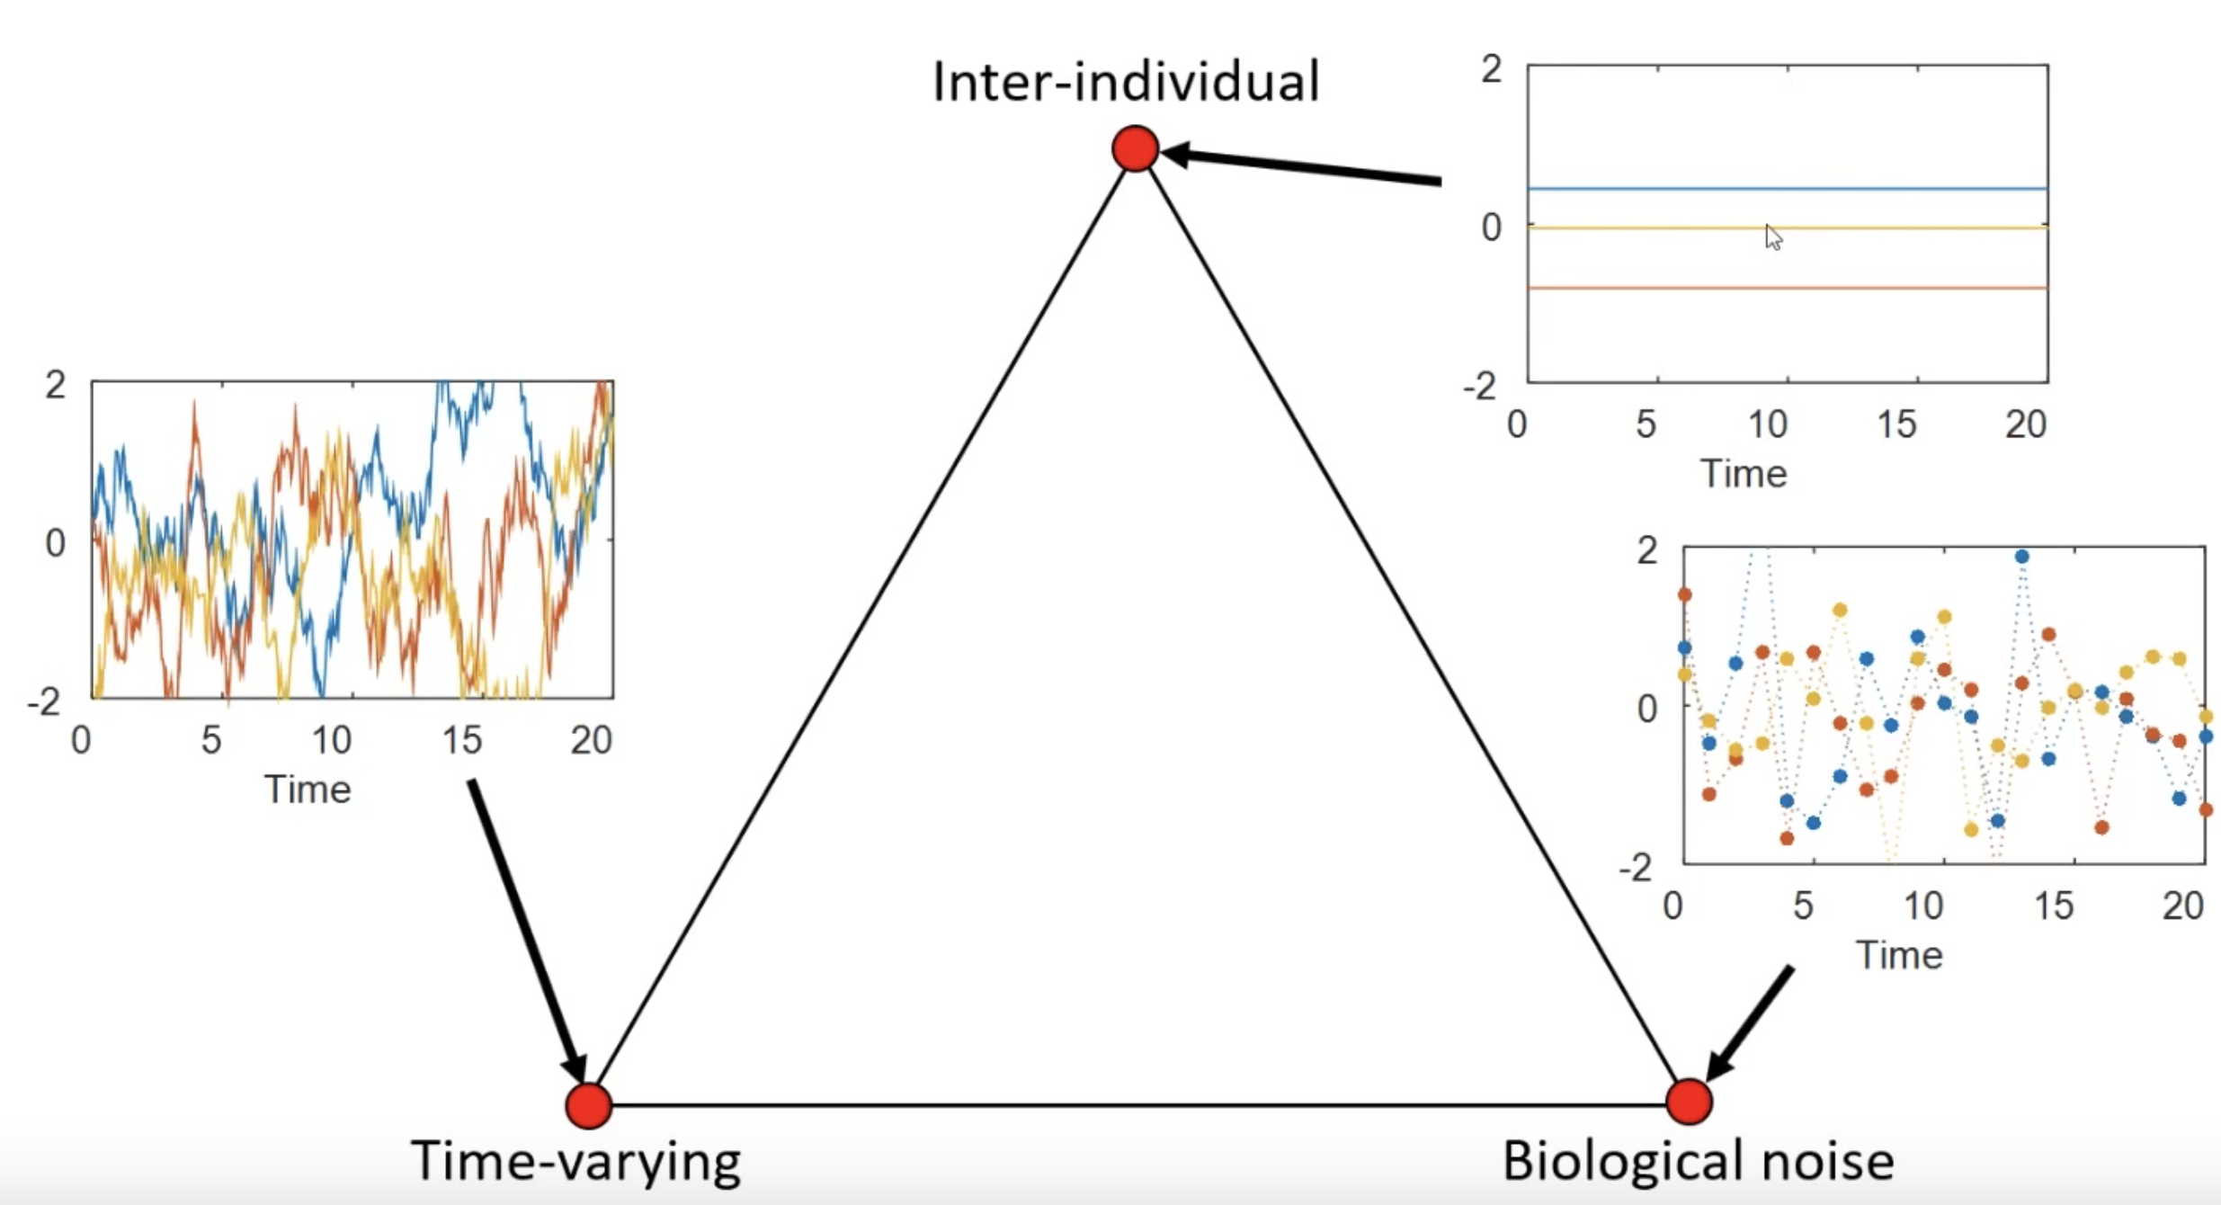
Random sampling can lead to spurious conclusions in longitudinal studies.
Measurements of microbiota can differ substantially from the underlying true community structure.
DNA of samples are randomly selected, processed, and then included in the subsequent step.
The randomness of this data generation process introduces uncertainty into microbiome measurements.
Technical variation from sample processing can influence ex vivo microbiota dynamics, accounting for 76% of community variation on hourly timescales.
https://drive.google.com/file/d/1U36NyMinKAm1R2rwgRb0fJUFVHbeYS9J/view
Silverman, J.D., Durand, H.K., Bloom, R.J. et al. Dynamic linear models guide design and analysis of microbiota studies within artificial human guts. Microbiome 6, 202 (2018)

Slide 36
Microbiome diversity is influenced by chance encounters
Genetically identical worms were put into identical environments and fed them the same diet.
The worms developed very different populations of bacteria in their gut, depending on which bacteria happened to make it there first.
When the experiment began, the worms had no bacteria in their digestive tracts, but after being exposed to the identical bacterial diet, the worms each generated very different microbe populations in their guts.
Vega NM, Gore J (2017) Stochastic assembly produces heterogeneous communities in the Caenorhabditis elegans intestine. PLOS Biology 15(3): e2000633.

Slide 37
Studies involving multiple individuals over time should design the experiment in a way that will subsequently be utilized by the the data modeling scheme.
Seasonality effects can also be important to consider in experimental design.
While perhaps most obvious in environmental studies, dietary changes surrounding holidays or weekends, or even natural circadian variation can also be important factors to consider.
Silverman, J.D., Durand, H.K., Bloom, R.J. et al. Dynamic linear models guide design and analysis of microbiota studies within artificial human guts. Microbiome 6, 202 (2018)
Notes:
multi-person studies of the effect of a targeted intervention may want to collect samples at similar temporal distances from the intervention. Such synchronization allows for richer questions to be investigated and greatly reduces modeling complexity.

Slide 38
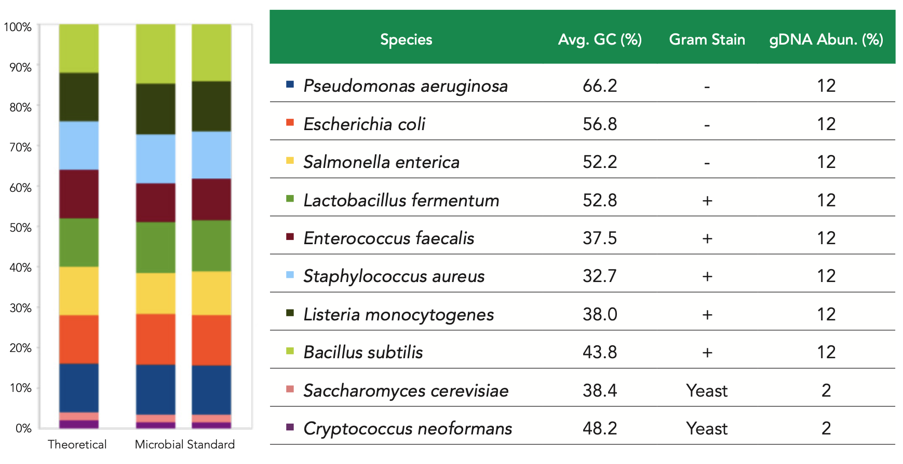
Microbiome Standards - Mock Communities
Mock community control composed of predetermined ratios of Microbes/DNA from a mixture of bacterial species.
Quantification of sequencing error
Identify bias introduced during the sampling and library preparation processes.
Pre-prepared bacterial communities are available in two different formats: DNA mock communities and whole-cell mock communities.
Whole-cell mock communities are useful for establishing the efficiency of the DNA extraction step.
DNA mock communities will only assess the efficiency of PCR, clean-up, sequencing, and analysis steps.
Mock communities are available from the American Type Culture Collection (ATCC - BIE) and Zymo Research.
https://www.zymoresearch.com/products/zymobiomics-microbial-community-standard

Slide 39
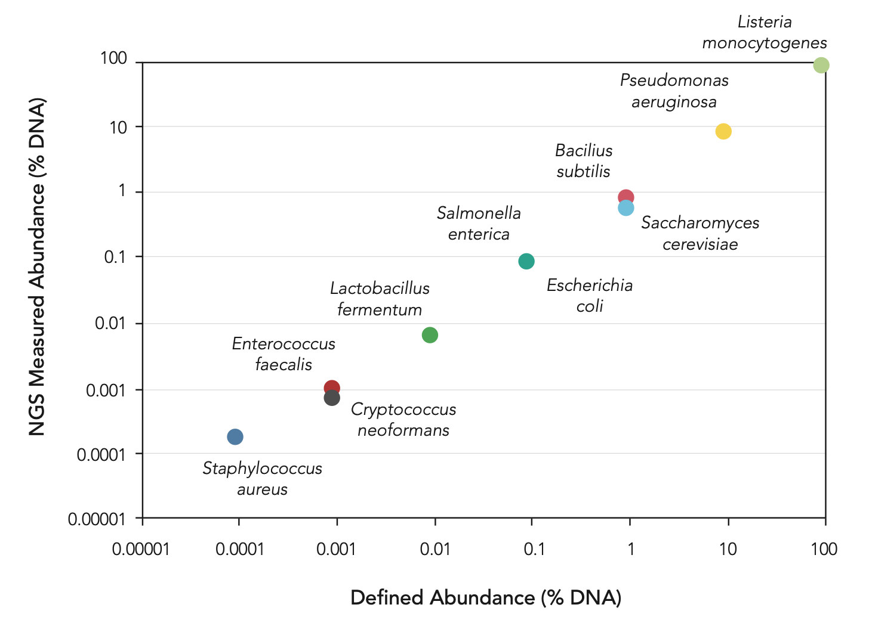
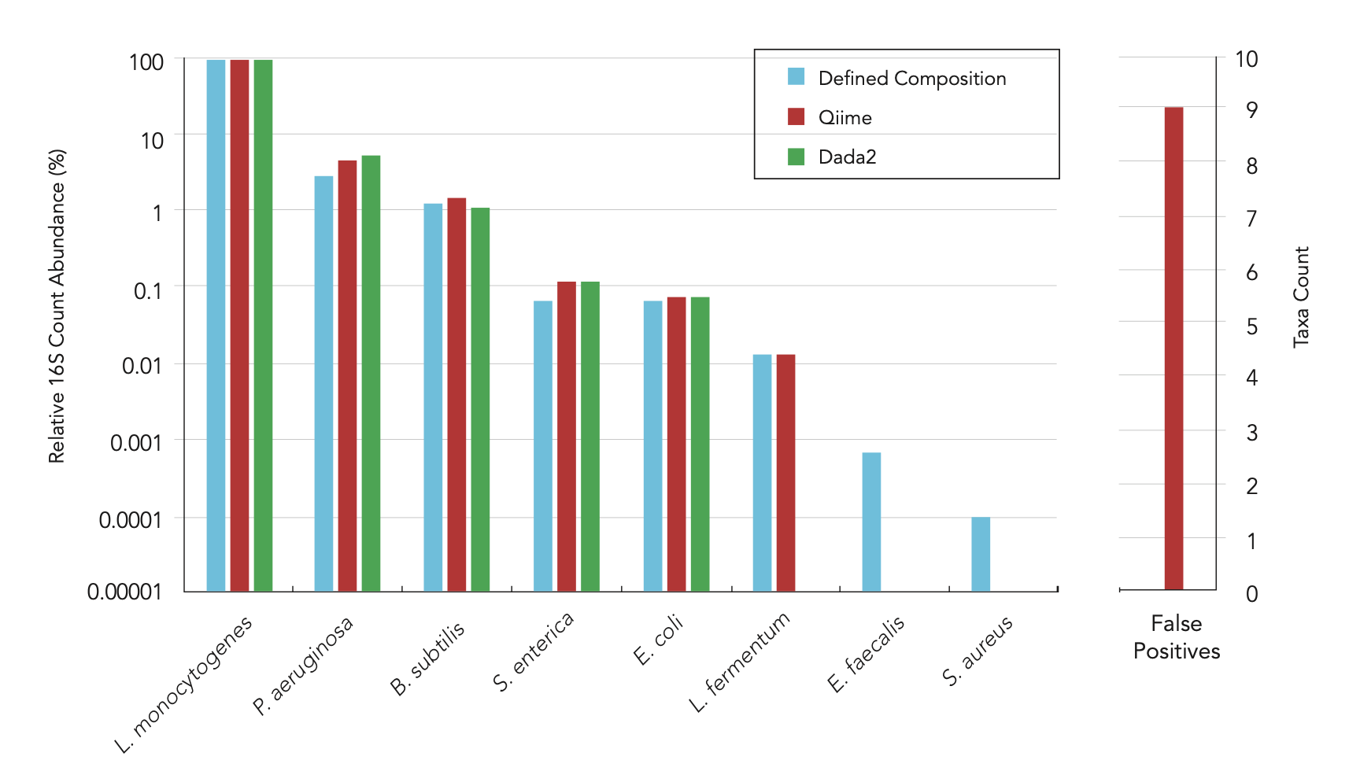
Staggered Mock Communities
Zymo Research’s Microbial Community Standard includes three easy-to-lyse Gram-negative bacteria (e.g. Escherichia coli), five tough-to-lyse Gram-positive bacteria (e.g. Listeria monocytogenes), and two tough-to-lyse yeasts (e.g. Cryptococcus neoformans)
https://www.zymoresearch.com/products/zymobiomics-microbial-community-standard-ii-log-distribution

Slide 40
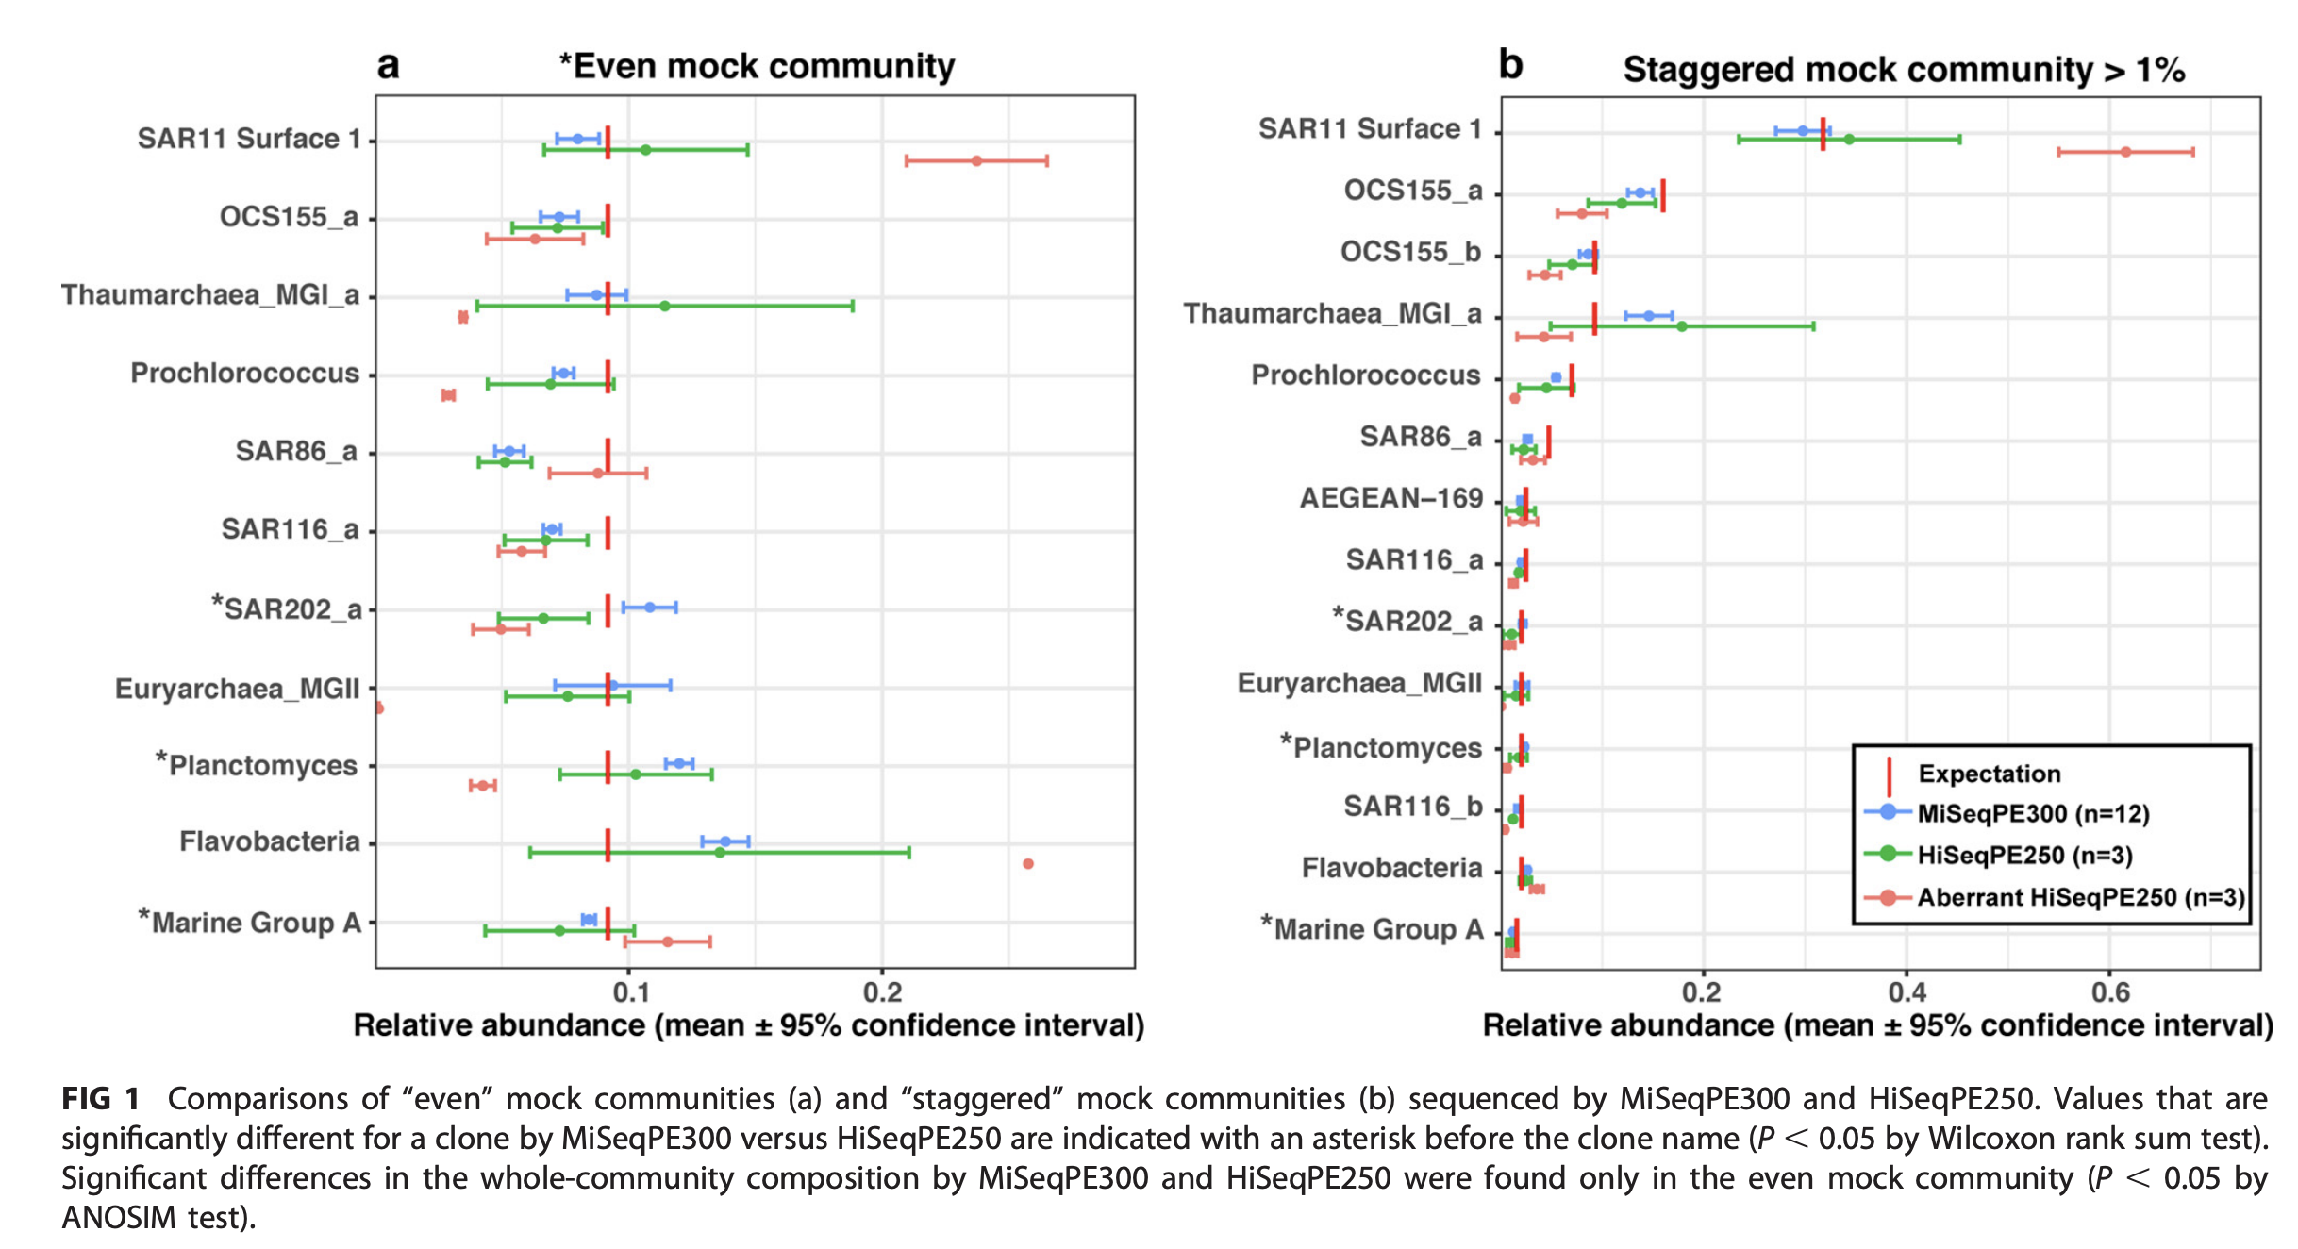
Mock communities help identify aberrant sequencing run
Y.-C. Yeh, D. M. Needham, E. T. Sieradzki, J. A. Fuhrman, Taxon Disappearance from Microbiome Analysis Reinforces the Value of Mock Communities as a Standard in Every Sequencing Run. mSystems 3, e00023-00018 (2018).
Notes:
Euryarchaea marine group II almost disappeared (i.e., 0 in the staggered mock community when it should have been ~1.8% and ~0.15% in the even mock community when it should have been ~9%), Thaumarchaea and Prochlorococcus were underrepresented (more than twofold) and SAR11 and Flavobacteria were overrepresented (more than twofold).

Slide 41
Microbiome Standards - Spike-in Controls
Unlike mock communities, these standards are added directly to samples.
Quality control can be performed on a per-sample basis.
Care must be taken to select bacteria which are highly unlikely to occur in the samples of interest.
Example:
Imtechella halotolerans(Gram-negative) and Allobacillus halotolerans (Gram-positive) – which are alien to human microbiome.

Slide 42
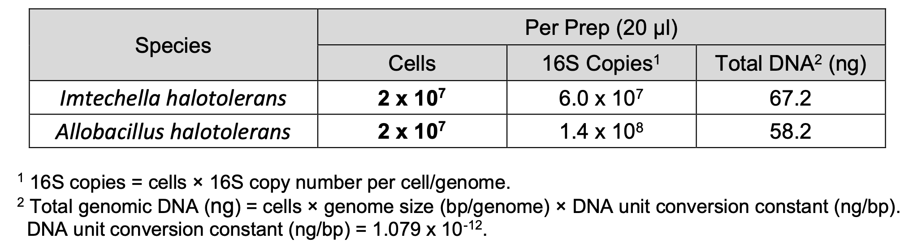
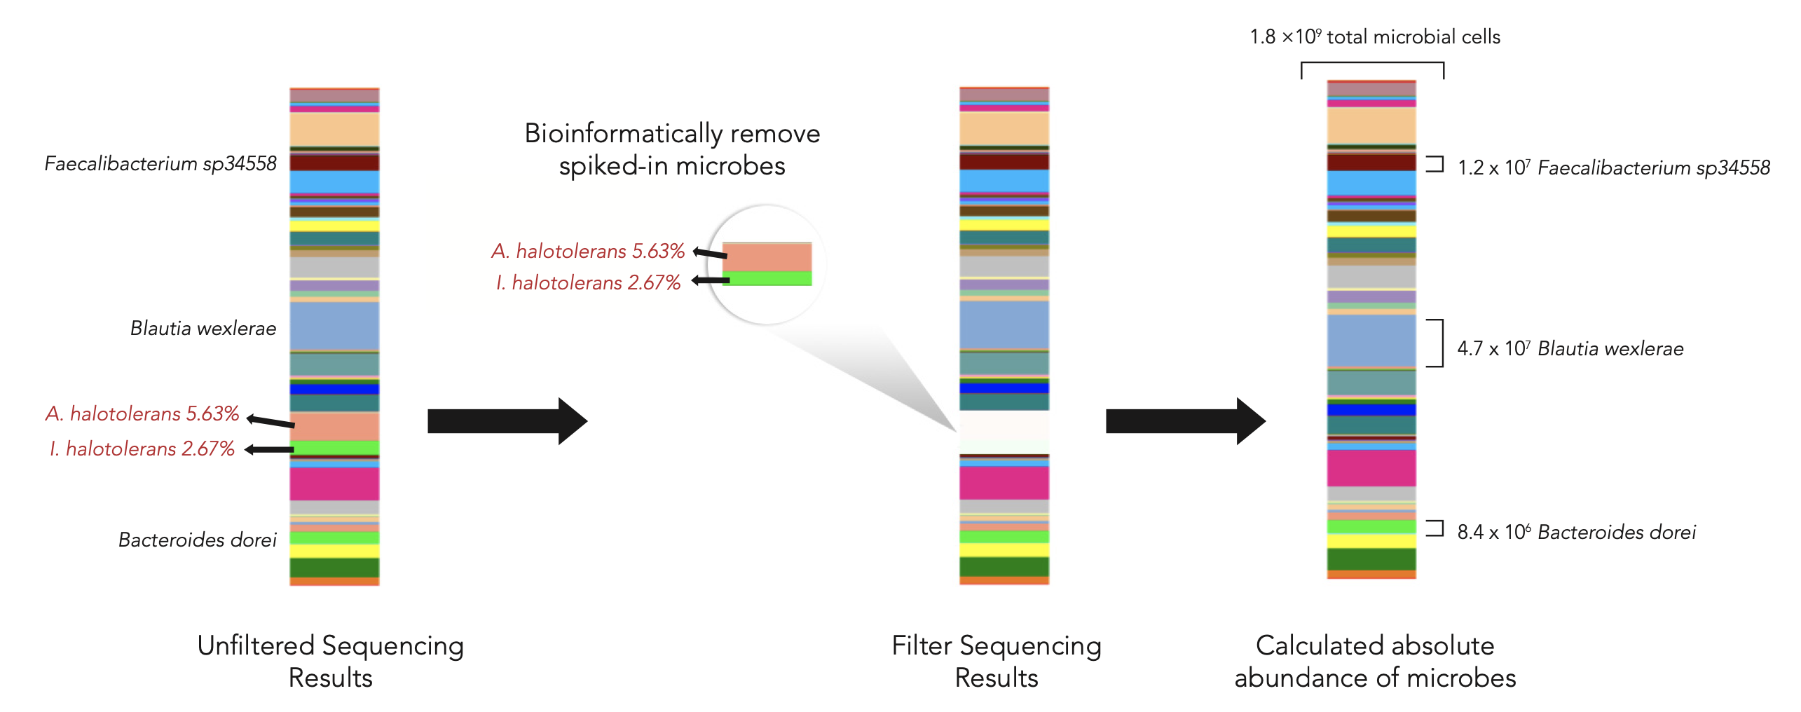
Spike-in controls
Microbial Composition
Differences in abundance ratio indicate potential workflow bias.
If the abundance of I. halotolerans is much higher than that of A. halotolerans.
Bias during DNA extraction
A. halotolerans is Gram-positive, tougher to lyse than I. halotolerans.
https://www.zymoresearch.com/collections/zymobiomics-microbial-community-standards/products/zymobiomics-spike-in-control-i-high-microbial-load
Notes:
Imtechella halotolerans – 3 16S copies
Allobacillus halotolerans – 7 16S copies

Slide 43
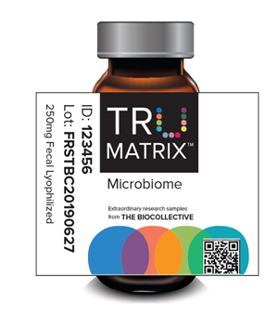
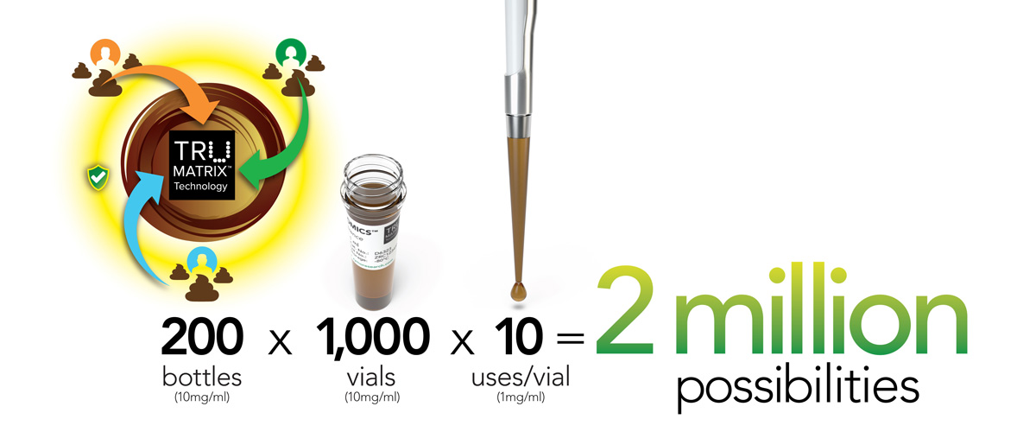
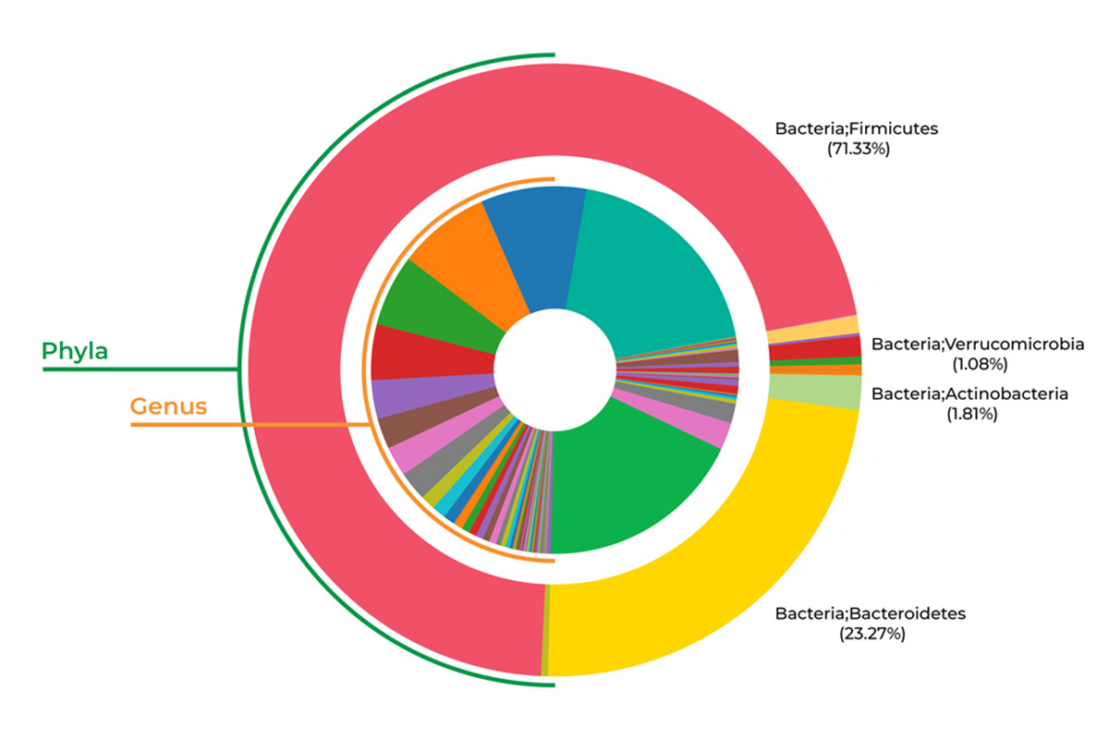
TRUMATRIX Microbiome Standard
A standard developed from real human fecal material, with funding from NIH - Mosaic Microbiome Community
Prepared from pooled stool samples.
Deeply sequenced using targeted, metagenomic, and metatranscriptomic sequencing. (Raw data made available)
https://www.zymoresearch.com/pages/zymobiomics-fecal-reference-with-trumatrix-technology

Slide 44


Amos GCA, Logan A, Anwar S, Fritzsche M, Mate R, Bleazard T, Rijpkema S. Developing standards for the microbiome field. Microbiome. 2020 Jun 26;8(1):98. doi: 10.1186/s40168-020-00856-3. PMID: 32591016; PMCID: PMC7320585.
Tourlousse DM, Narita K, Miura T, Sakamoto M, Ohashi A, Shiina K, Matsuda M, Miura D, Shimamura M, Ohyama Y, Yamazoe A, Uchino Y, Kameyama K, Arioka S, Kataoka J, Hisada T, Fujii K, Takahashi S, Kuroiwa M, Rokushima M, Nishiyama M, Tanaka Y, Fuchikami T, Aoki H, Kira S, Koyanagi R, Naito T, Nishiwaki M, Kumagai H, Konda M, Kasahara K, Ohkuma M, Kawasaki H, Sekiguchi Y, Terauchi J. Validation and standardization of DNA extraction and library construction methods for metagenomics-based human fecal microbiome measurements. Microbiome. 2021 Apr 29;9(1):95. doi: 10.1186/s40168-021-01048-3. PMID: 33910647; PMCID: PMC8082873.

Slide 45
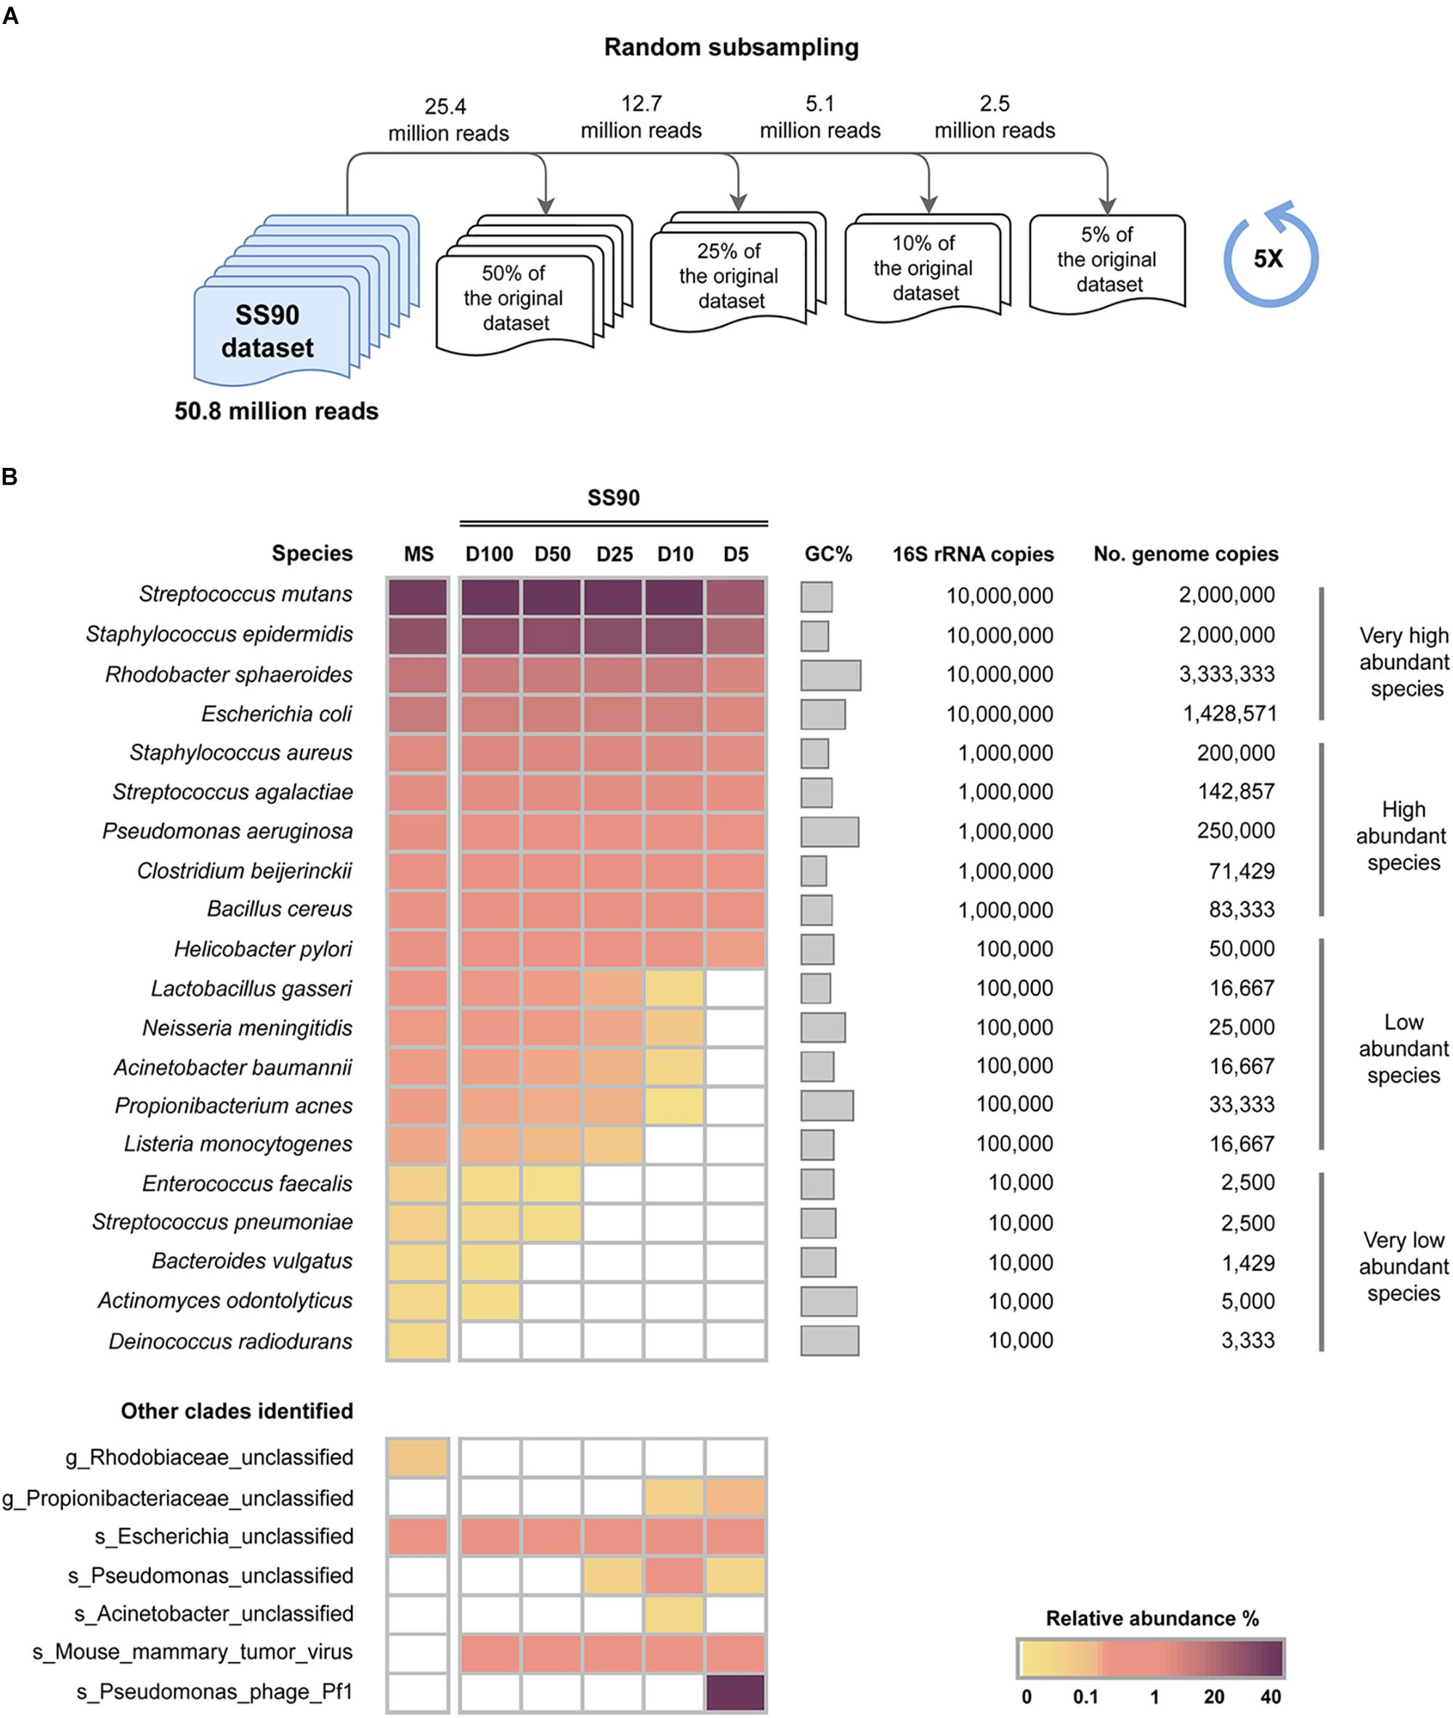
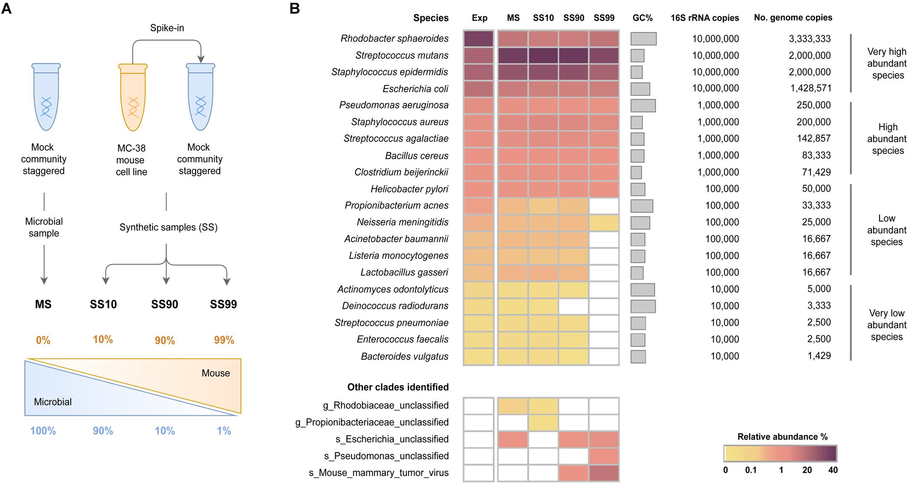
Sequencing Depth – Host Genome
The amount of host DNA poses a major challenge to metagenome analysis.
Pereira-Marques, J., Hout, A., Ferreira, R. M., Weber, M., Pinto-Ribeiro, I., van Doorn, L. J., ... & Figueiredo, C. (2019). Impact of host DNA and sequencing depth on the taxonomic resolution of whole metagenome sequencing for microbiome analysis. Frontiers in microbiology, 10, 1277.

Slide 46




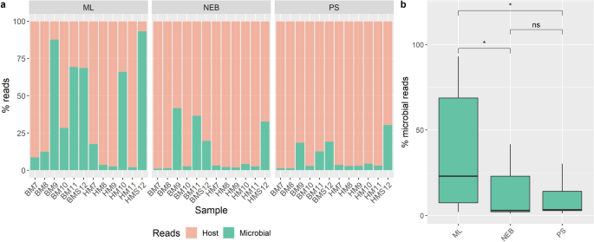
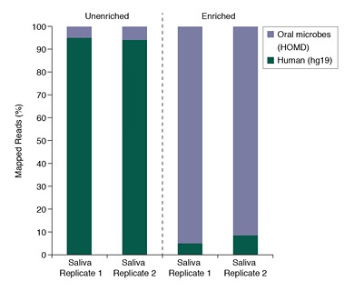
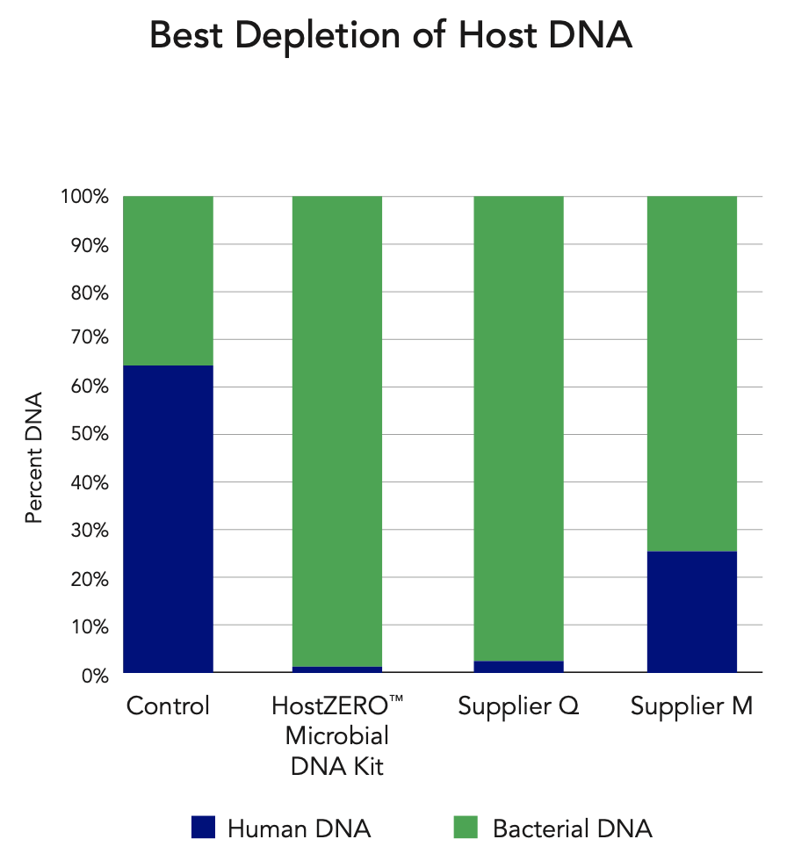
Microbiome DNA Enrichment
Evaluation of microbiome DNA enrichment should be performed with multiple kits
NEBNext Microbiome DNA enrichment kit (New England Biolabs Inc., Ipswitch, MA, USA)
Molzym Ultra-Deep Microbiome Prep (Molzym, Bremen, Germany).
QIAamp DNA Microbiome Kit (Qiagen, Hilden, Germany).
HostZERO microbial DNA kit (Zymo Research, California, USA).
Yap, M., Feehily, C., Walsh, C. J., Fenelon, M., Murphy, E. F., McAuliffe, F. M., ... & Cotter, P. D. (2020). Evaluation of methods for the reduction of contaminating host reads when performing shotgun metagenomic sequencing of the milk microbiome. Scientific reports, 10(1), 1-11.

Slide 47
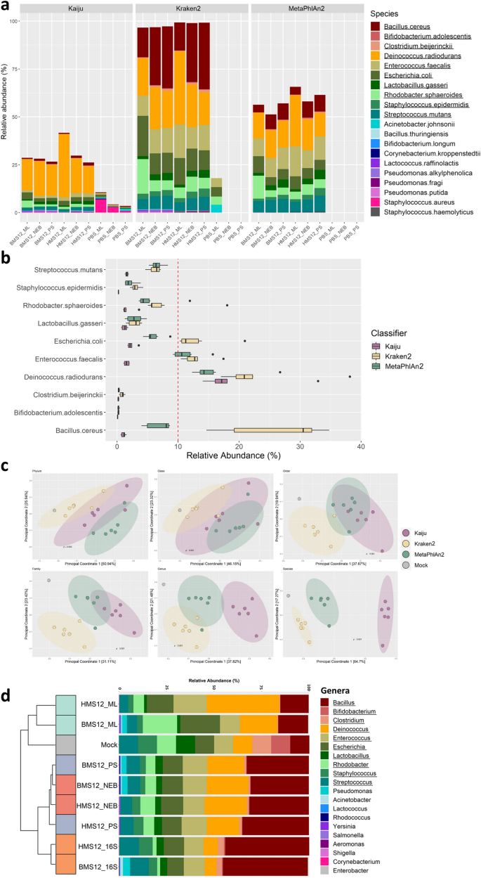
Mock community samples impacted by choice of bioinformatics classifier rather than method!!!!!!
It is important to test multiple bioinformatics pipelines with your pilot study.
Yap, M., Feehily, C., Walsh, C. J., Fenelon, M., Murphy, E. F., McAuliffe, F. M., ... & Cotter, P. D. (2020). Evaluation of methods for the reduction of contaminating host reads when performing shotgun metagenomic sequencing of the milk microbiome. Scientific reports, 10(1), 1-11.

Slide 48
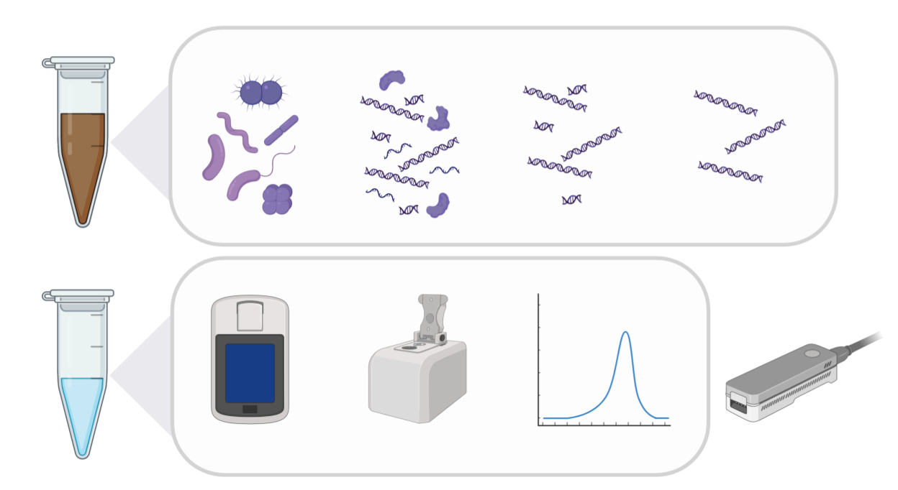

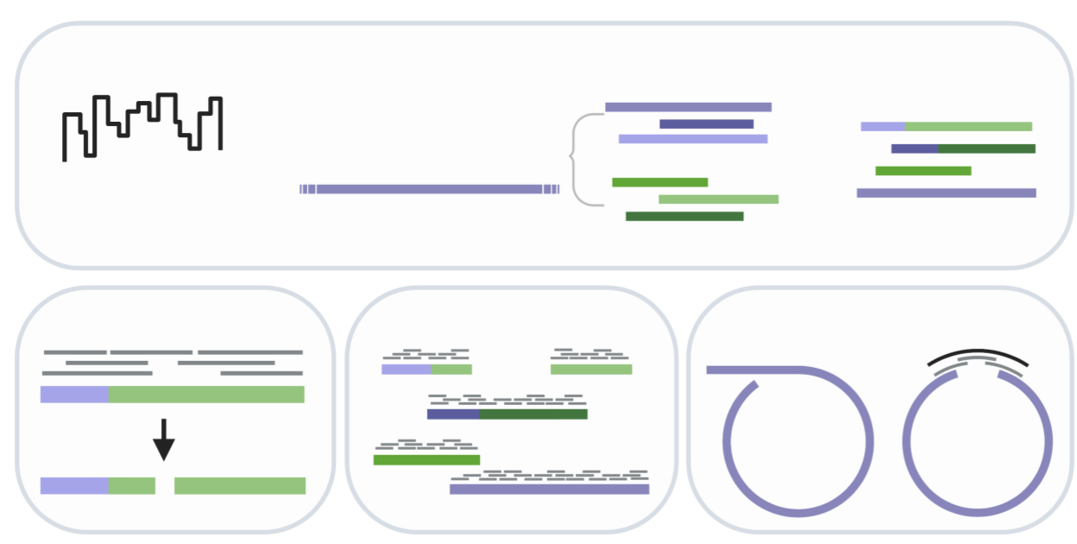
Long-Read Whole Genome Metagenomics
Nanopore sequencing can yield highly contiguous or circular bacterial genomes from a complex human gut sample.
High molecular weight DNA extraction workflow
Moss, E.L., Maghini, D.G. & Bhatt, A.S. Complete, closed bacterial genomes from microbiomes using nanopore sequencing. Nat Biotechnol 38, 701–707 (2020). https://doi.org/10.1038/s41587-020-0422-6
Post-sequencing bioinformatic workflow

Slide 49
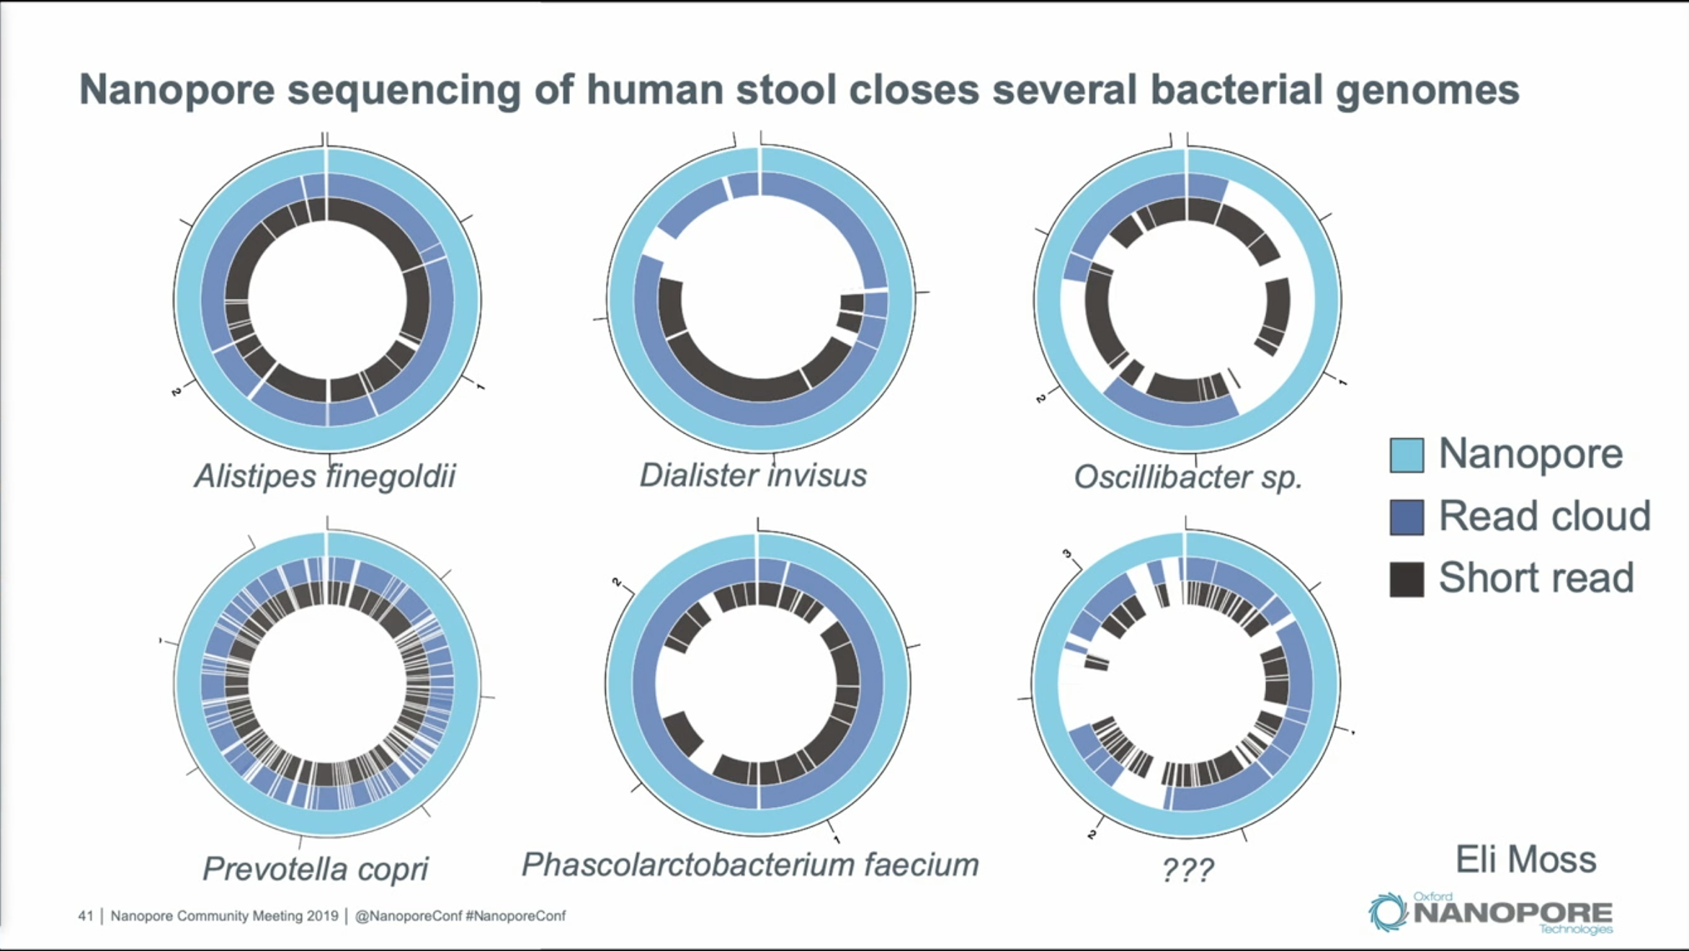
Circulaization of bacterial genomes would help to gain insight into mobile genetic elements.
https://nanoporetech.com/resource-centre/genomes-metagenomes-assembling-bacterial-genomes-nanopore-sequencing

Slide 50
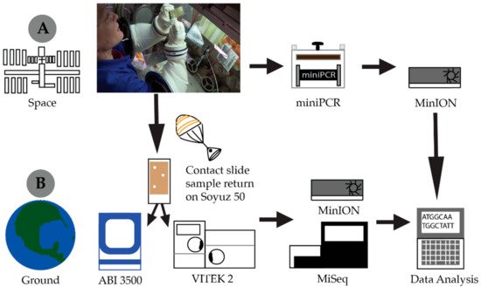
Metagenomic sequencing – Environmental Research On-site
Given the advancements of nanopore sequencing technology it is now made possible to perform metagenomic sequence on-site at remote locations.
Burton, A.S. et al. Off Earth identification of bacterial populations using 16S rDNA nanopore sequencing. Genes. 11(1), 76 (2020).
Ducluzeau A-L, Lekanoff RM, Khalsa NS, Smith HH, Drown DM. Introducing DNA sequencing to the next generation on a research vessel sailing the Bering Sea through a storm. 2019. Available from: https://www.preprints.org/manuscript/201905.0113

Slide 51
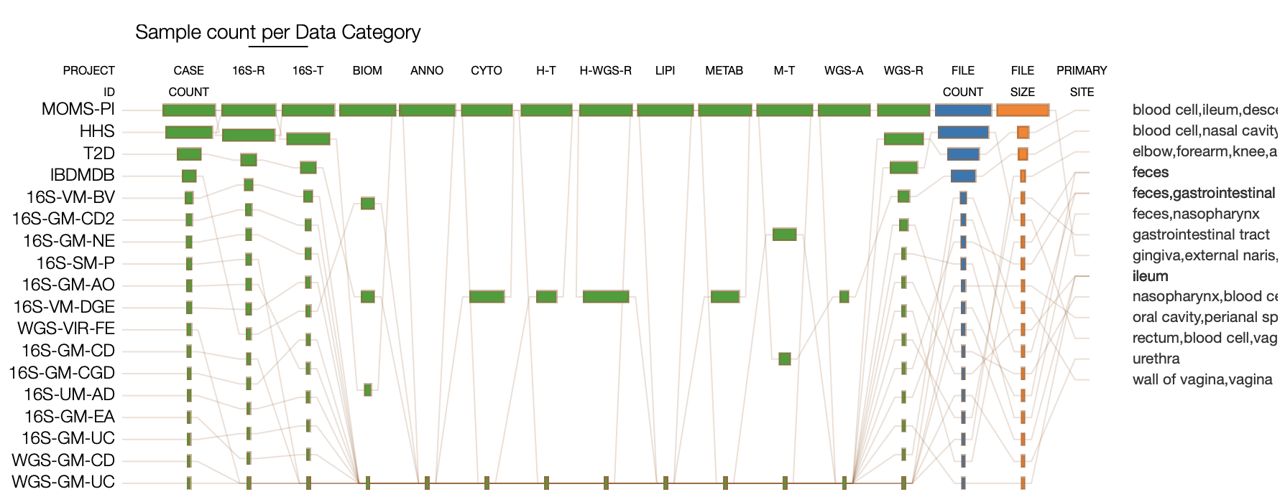
Human Microbiome Project Data Analysis and Coordination Portal https://portal.hmpdacc.org
Notes:
Multi-Omic Microbiome Study-Pregnancy Initiative (MOMS-PI)

Slide 52
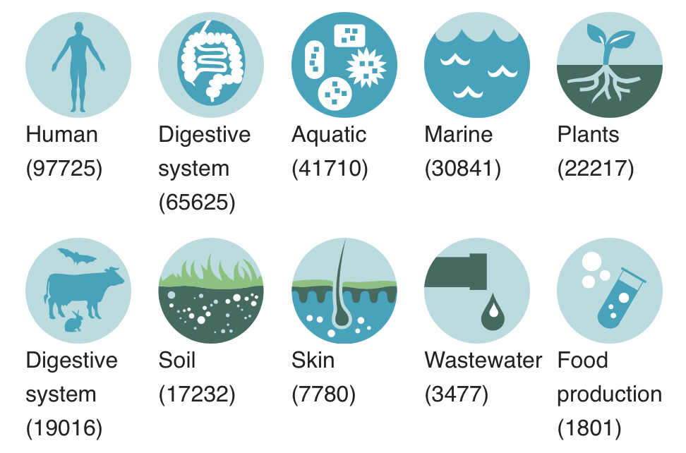
Mgnify (EBI): Metagenome database with assemblies https://www.ebi.ac.uk/metagenomics
Mitchell, A. L., Almeida, A., Beracochea, M., Boland, M., Burgin, J., Cochrane, G., ... & Sakharova, E. (2020). MGnify: the microbiome analysis resource in 2020. Nucleic acids research, 48(D1), D570-D578.

Slide 53
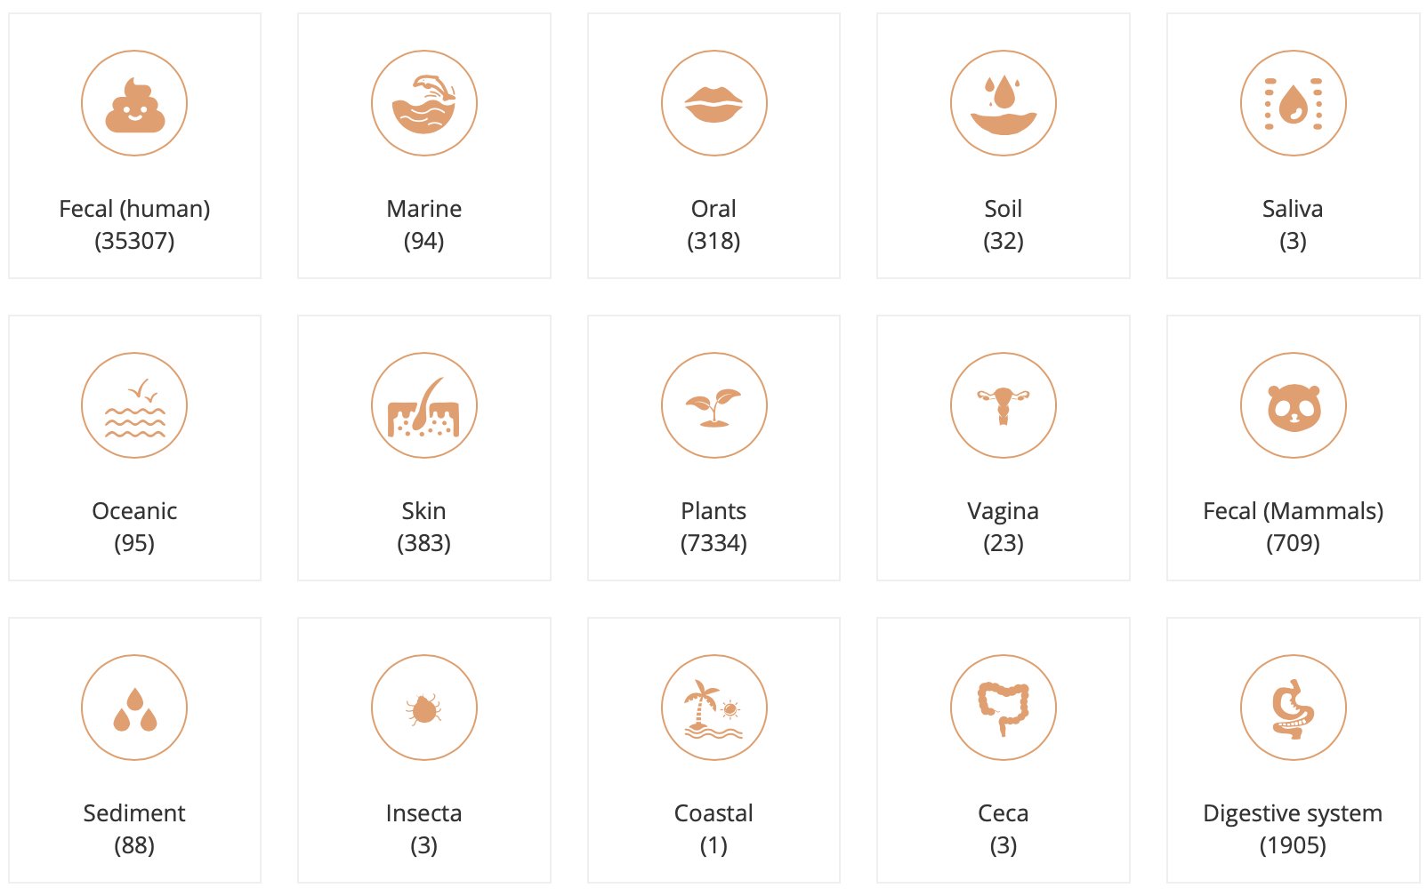
MDB: A microbiome database hosted by China National GeneBank(CNGB) https://db.cngb.org/microbiome

Slide 54
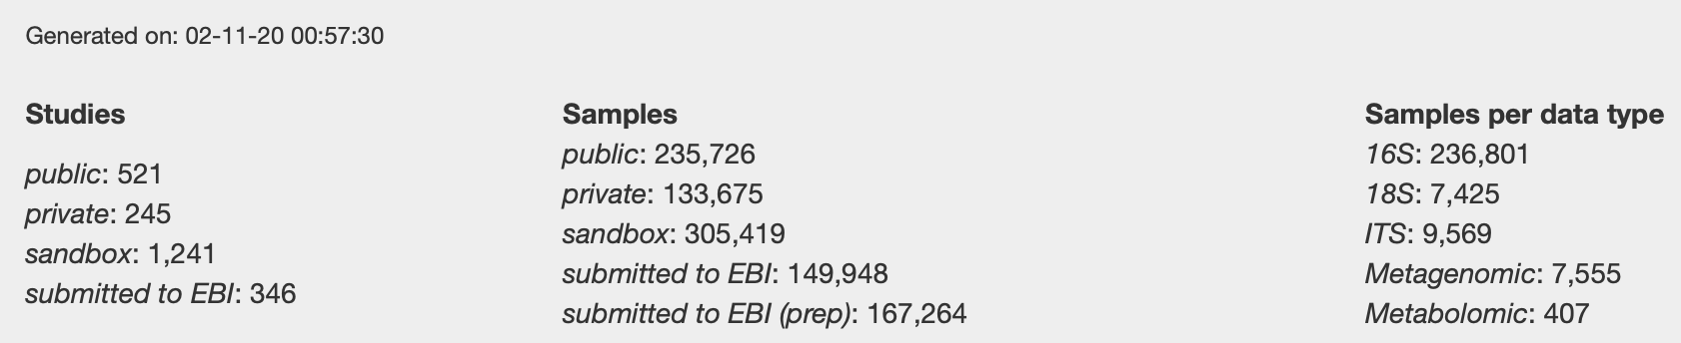
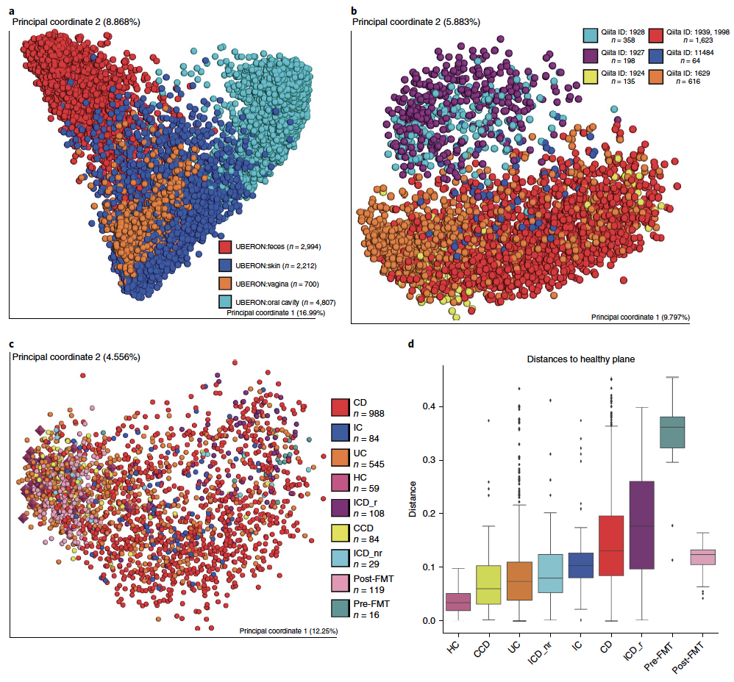
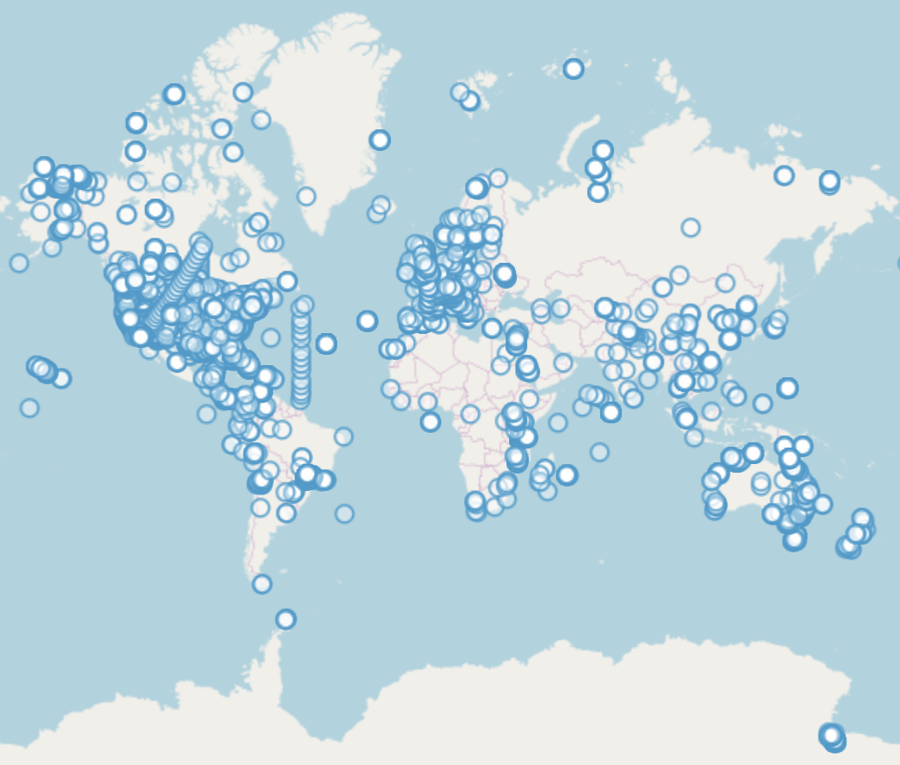
QIITA: rapid, web-enabled microbiome meta-analysis https://qiita.ucsd.edu
Gonzalez, A., Navas-Molina, J. A., Kosciolek, T., McDonald, D., Vázquez-Baeza, Y., Ackermann, G., ... & Sanders, J. G. (2018). Qiita: rapid, web-enabled microbiome meta-analysis. Nature methods, 15(10), 796-798.

Slide 55
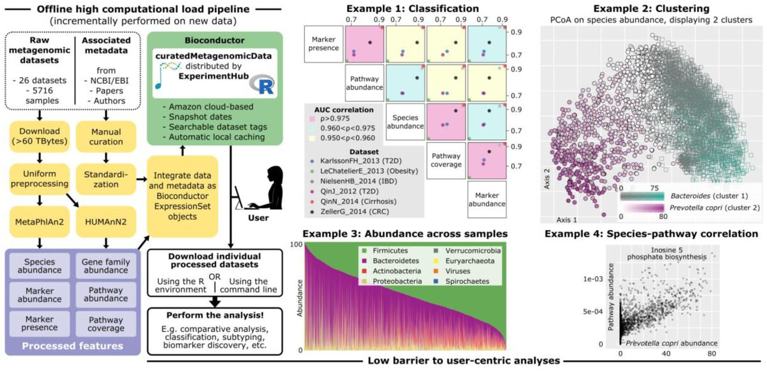
curatedMetagenomicData : Curated and processed metagenomic data through ExperimentHub
Pasolli, E., Schiffer, L., Manghi, P., Renson, A., Obenchain, V., Truong, D. T., ... & Huttenhower, C. (2017). Accessible, curated metagenomic data through ExperimentHub. Nature methods, 14(11), 1023.

Slide 56
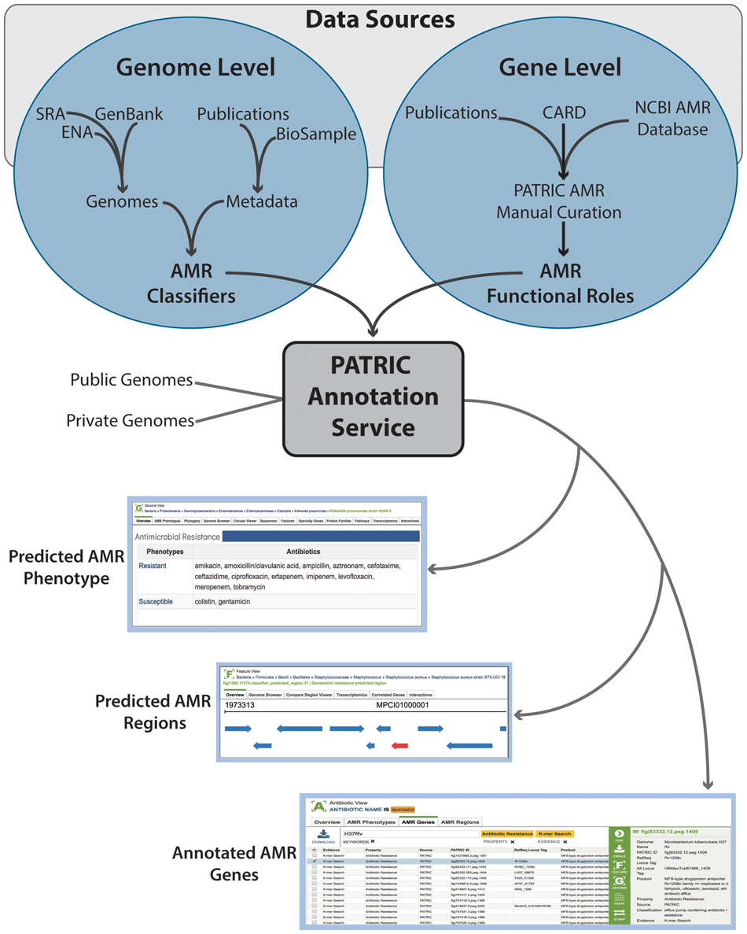
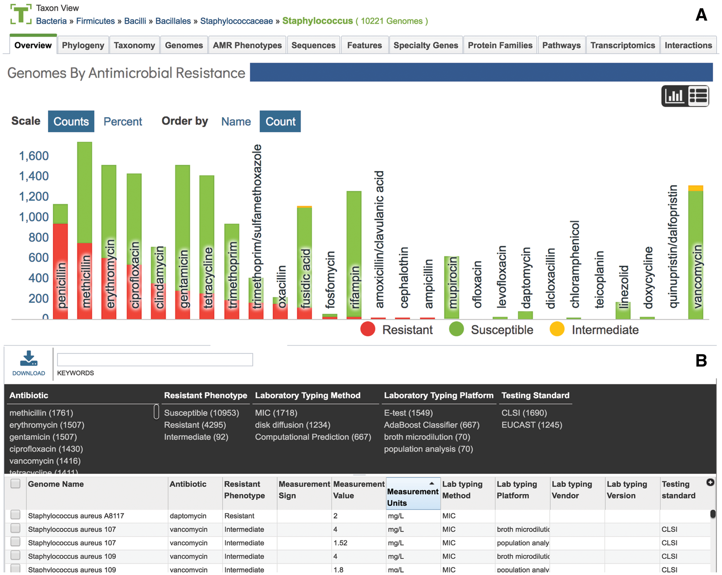
PATRIC: Antibiotic resistance data https://patricbrc.org
National Database of Antibiotic Resistant Organisms (NDARO)
Antonopoulos, D. A., Assaf, R., Aziz, R. K., Brettin, T., Bun, C., Conrad, N., ... & Kenyon, R. W. (2019). PATRIC as a unique resource for studying antimicrobial resistance. Briefings in bioinformatics, 20(4), 1094-1102.

Slide 57
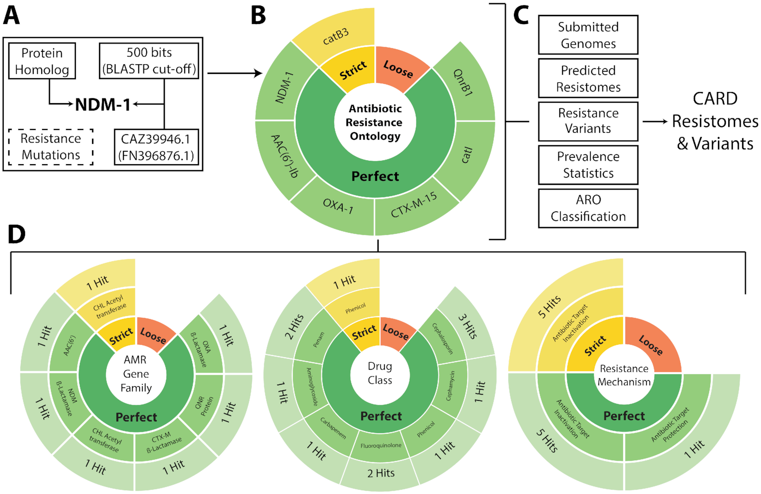
CARD: antibiotic resistance gene database RGI - Resistance Gene Identifier (cli) https://card.mcmaster.ca
Alcock, B. P., Raphenya, A. R., Lau, T. T., Tsang, K. K., Bouchard, M., Edalatmand, A., ... & Min, S. Y. (2020). CARD 2020: antibiotic resistome surveillance with the comprehensive antibiotic resistance database. Nucleic acids research, 48(D1), D517-D525.

Slide 58
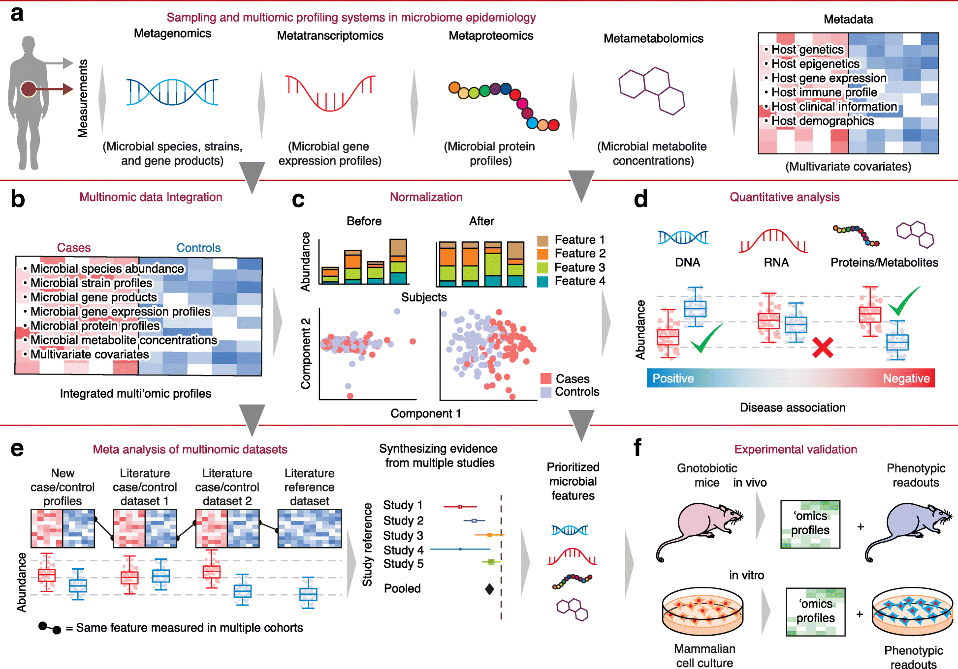
Microbiome molecular epidemiology.
Mallick, H., Ma, S., Franzosa, E.A. et al. Experimental design and quantitative analysis of microbial community multiomics. Genome Biol 18, 228 (2017)

